Slide 1
PD1 regulates T cell exhaustion phenotypes and disease aggressiveness in CTCL
Jay Daniels, MD/PhD Candidate
Choi Laboratory, Northwestern University
EORTC Cutaneous Lymphoma Group
October 14th, 2021
Notes:
Good afternoon, its an honor to have the opportunity to present our work here today. My name is Jay Daniels, I work in Jae Choi’s lab at Northwestern University, and the title of this talk today is “PD1 regulates T cell exhaustion phenotypes and disease aggressiveness in CTCL”.

Slide 2
Disclosures
No relevant conflicts of interest
Notes:
No relevant disclosures

Slide 3
Clinical outcomes in CTCL are heterogenous even among stage matched patients

Slide 4
What are the molecular explanations for heterogeneity in clinical outcomes?
???
Clinical
phenotype
Mutations

Slide 5
Key outstanding questions
What is the molecular basis for heterogeneous clinical outcomes in CTCL?
Do TCR dependent differences help explain clinical variability?
Can we leverage molecular information to predict which patients will do poorly and require more aggressive therapies?

Slide 6
Hypothesis: CTCLs will show global hyper-responsiveness to TCR stimulation due to TCR activating mutations
Approach to correlate genomics with TCR dependent phenotypes:
+ whole genome sequencing

Slide 7
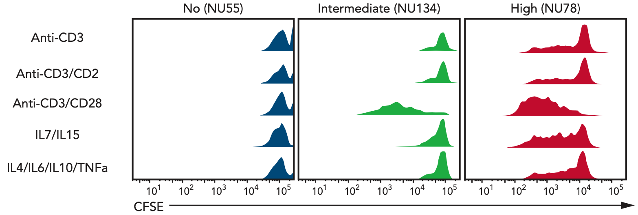
SS samples display a surprisingly heterogenous ability to proliferate ex vivo

Slide 8
Approach to identify molecular basis for heterogenous ex vivo proliferation

Slide 9
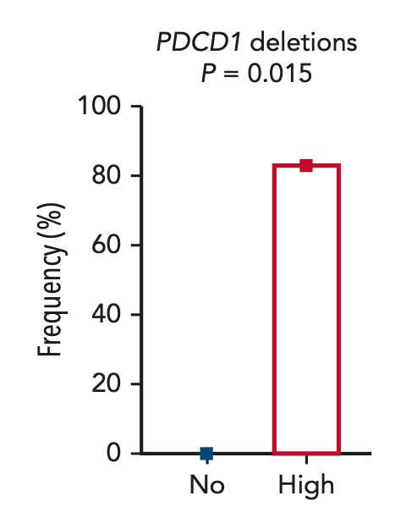
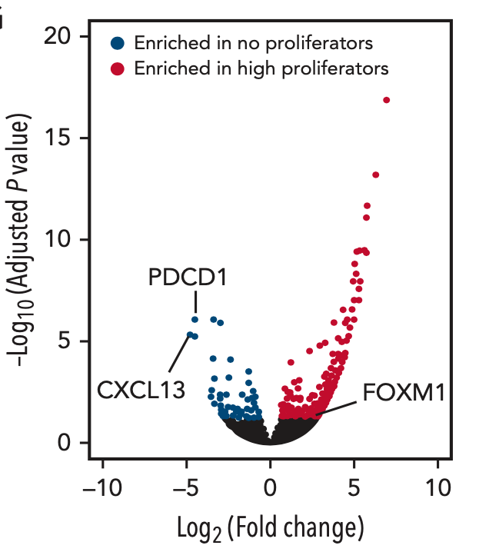
PD1 is the most significantly different mutation and transcript between high and no proliferators
DNAseq
RNAseq

Slide 10
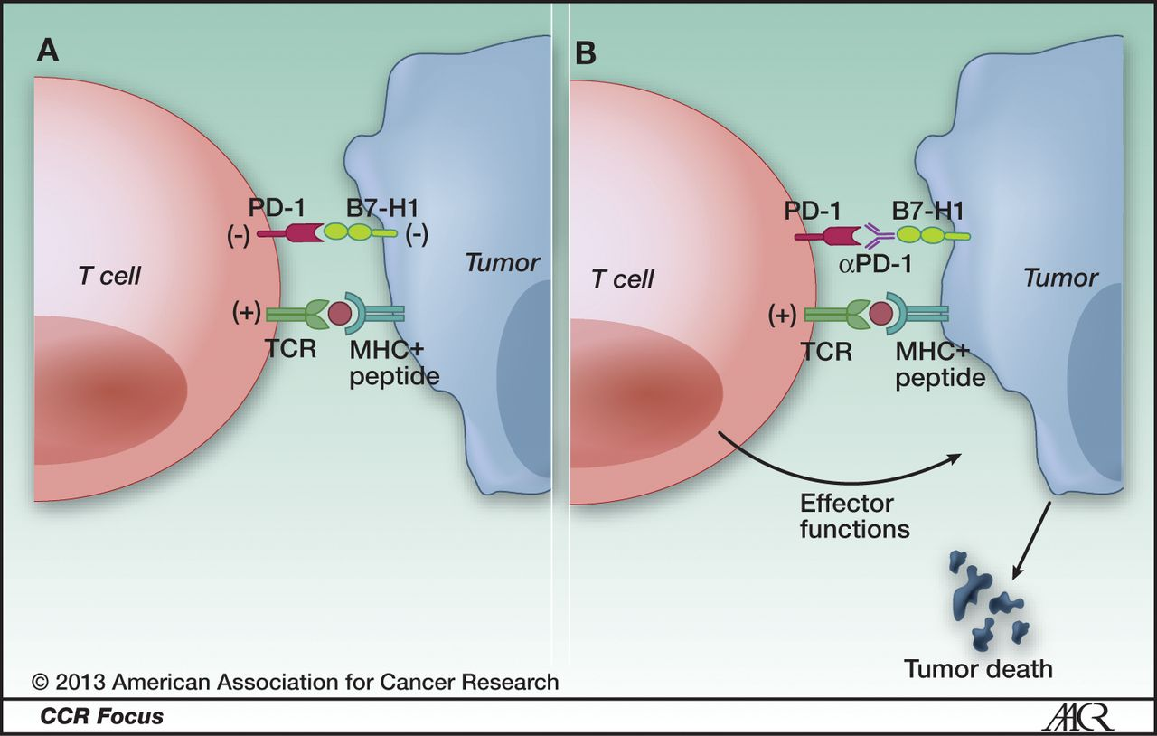
PD1 is a checkpoint inhibitor molecule that limits T cell effector functions and is associated with T cell exhaustion

Slide 11
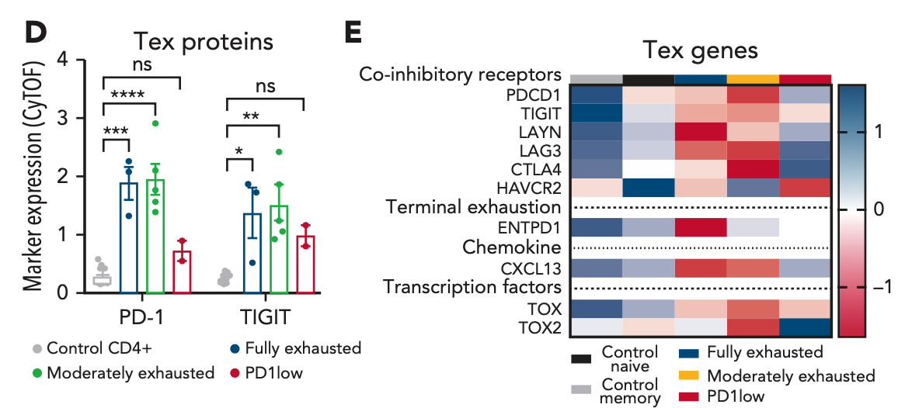
PD1low CTCLs lack surface or transcriptional signatures of exhaustion present in all other CTCLs

Slide 12
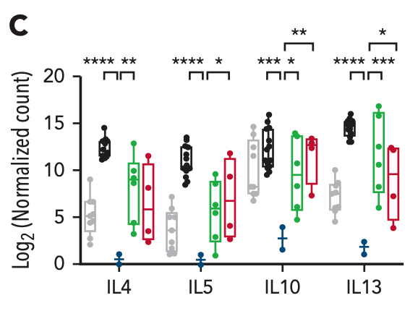
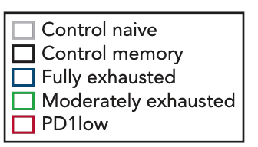
CTCLs show variable levels of cytokine production

Slide 13
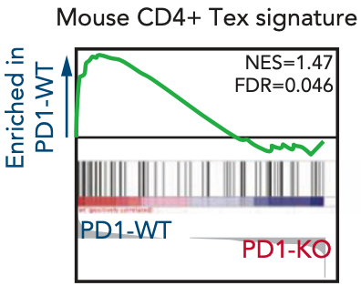
PD1 knockout is sufficient to reverse the T cell exhaustion signature in mouse oncogene expressing T cells

Slide 14
PD1 deletions are associated with increasing stage and worse overall survival
Stage IV
Stage II-III

Slide 15
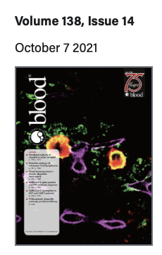
Conclusions and future directions
CTCLs display functional heterogeneity that is explained in part due to T cell exhaustion phenotypes
PD1 deletions reverse tumor T cell exhaustion and promote a worse prognosis in CTCL
Can PD1 genetic loss be used as a biomarker prospectively?
What are the mechanisms by which PD1 deletions promote CTCL aggressiveness? Are any of these pathways targetable?
Do these findings have implications for checkpoint blockade in CTCL? Is tumor cell intrinsic genetic deletion different from pharmacologic blockade, and if so, how?
More details:
Last week’s issue of Blood

Slide 16
Acknowledgements
Northwestern University
Collaborators
Joonhee Park
My mentor: Jae Choi
NU CTCL team:
Joan Guitart
Barbara Pro
Maria E. Martinez Escala
Jeffrey Sosman
Choi lab
Kim Ringbloom
Sara Choi
Jingyi Yang
Jane Thomas
Caroline Snowden
Katie Lee
Calvin Law
Yujin Lee
Mouse work (TUM):
Tim Wartewig
Jurgen Ruland
Cytof (BWH):
Deepak Rao
Funding
NIH/NCI T32CA09560
NIH/NCI F30CA265107
All patients and their families
Notes:
Thanks to everyone who contributed to this project, including the patients and all their families, and my funding sources.

Slide 17
Thanks for your attention! Questions?
Notes:
Thanks to everyone who contributed to this project, including the patients and all their families, and my funding sources.

