Slide 1
Subtype-specific differences in the genomic landscape of cutaneous T cell lymphomas
Jay Daniels, MD/PhD Candidate
Choi Laboratory, Northwestern University
EORTC Cutaneous Lymphoma Group
October 14th, 2021
Notes:
Good afternoon, its an honor to have the opportunity to present our work here today. My name is Jay Daniels, I work in Jae Choi’s lab at Northwestern University, and the title of this talk today is “Subtype-specific differences in the genomic landscape of cutaneous T cell lymphomas”.

Slide 2
Disclosures
No relevant conflicts of interest
Notes:
No relevant disclosures

Slide 3
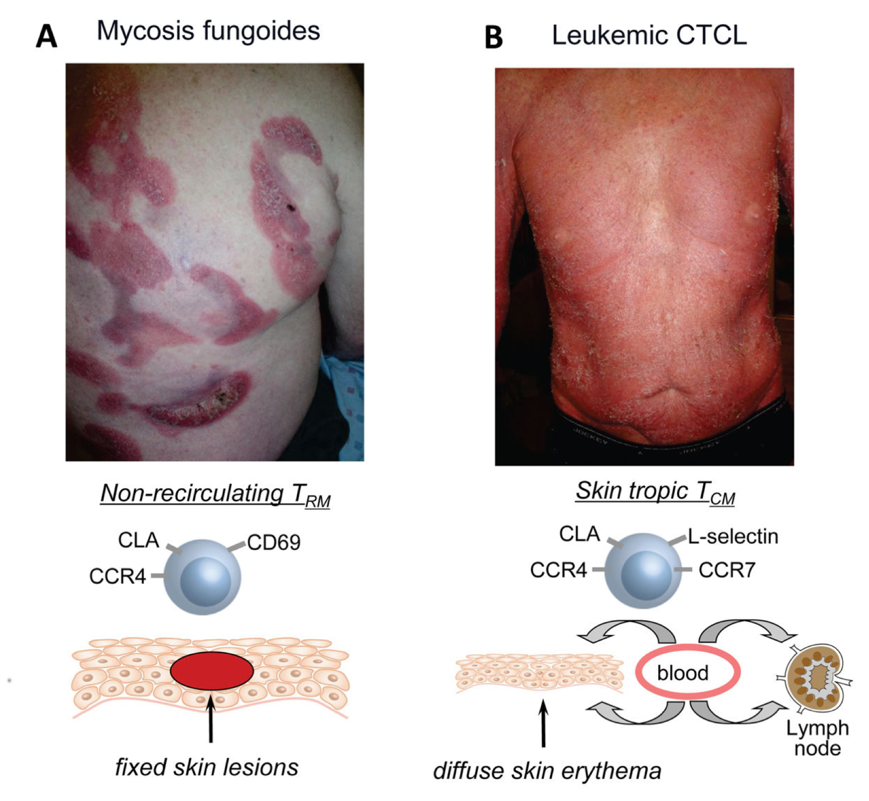
Relationship between MF and SS
Genetics?

Slide 4
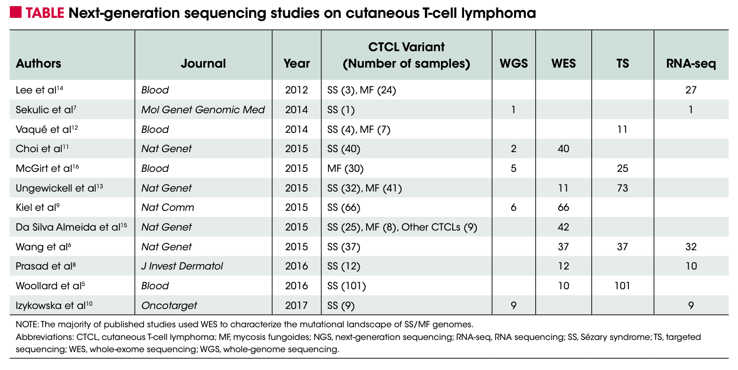
Sezary Syndrome is over-represented in next generation sequencing studies
Prevalence:
MF > SS (~12x)
Share of
WES/WGS studies:
SS > MF (~7x)

Slide 5
Key outstanding questions
What are the genetic similarities and differences between MF and SS?
Do MF and SS have different mutational signatures?
Can other types of samples such as MF-preceded SS provide insights?

Slide 6
Approach
DNA-sequencing
n=94
Published samples
CNVs (n=38), SNVs (n=203)
Analysis of significant copy number variants (CNVs) and point mutations (SNVs)
Comparison of clinical subtypes

Slide 7
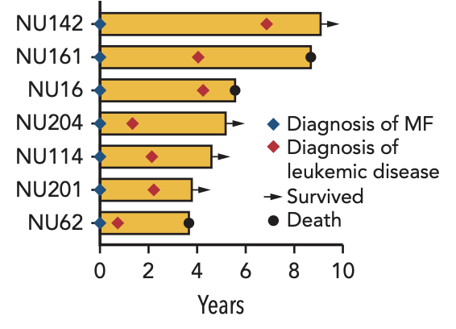
A subset of patients were diagnosed with skin-limited MF and subsequently developed leukemia and erythroderma

Slide 8
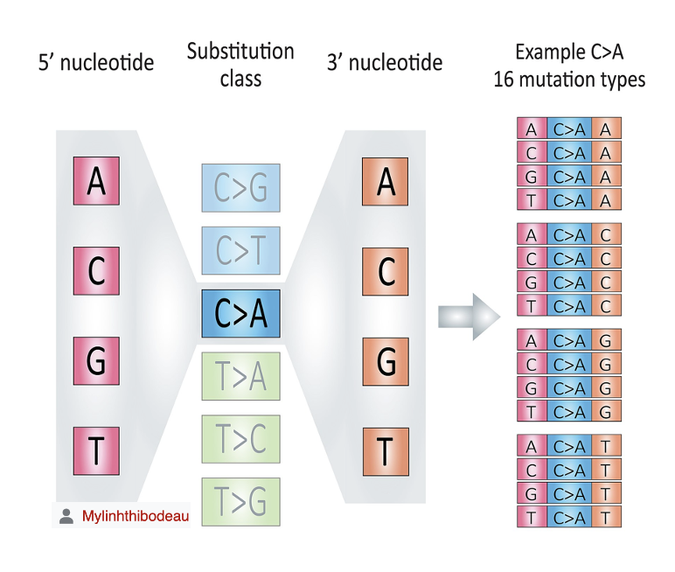
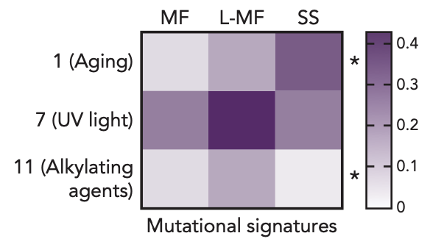
MF, L-MF, and SS all show strong enrichment of UV light mutational signatures

Slide 9
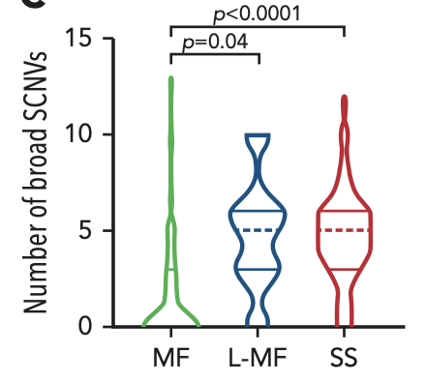
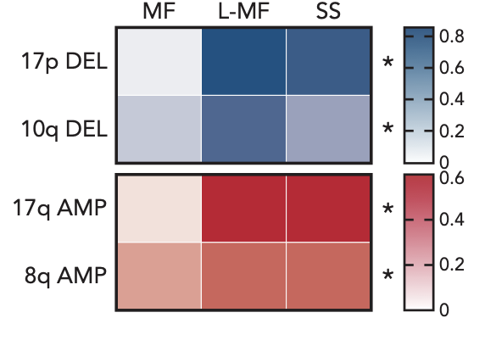
Patients with leukemic disease have a significantly higher burden of broad, recurrent CNVs

Slide 10
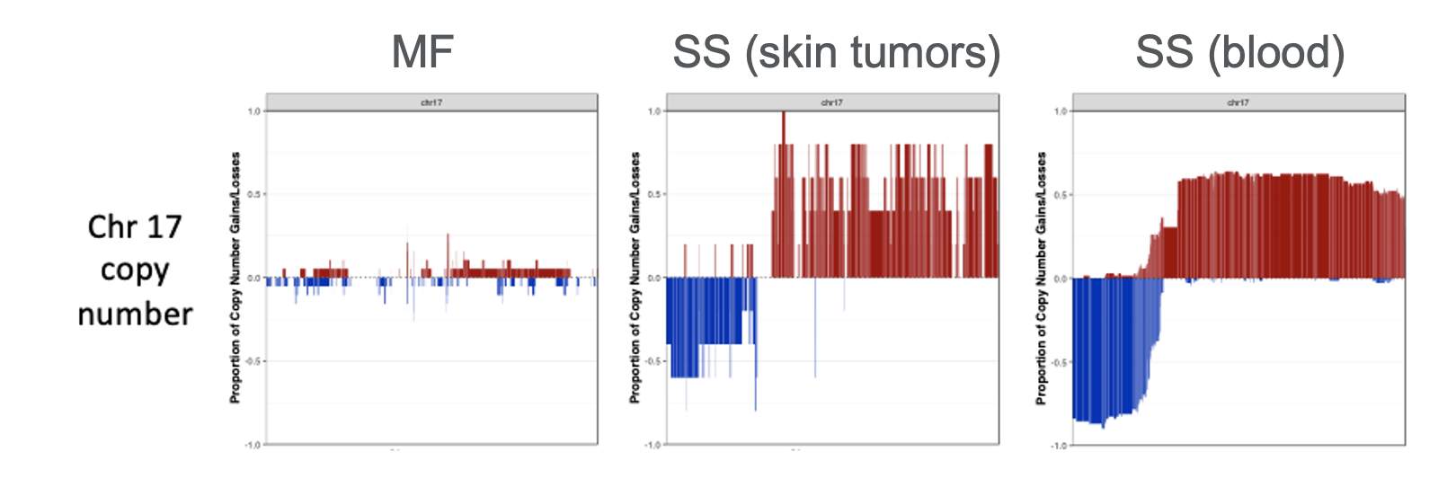
17p deletions and 17q amplifications are present in SS independent of site of sampling

Slide 11
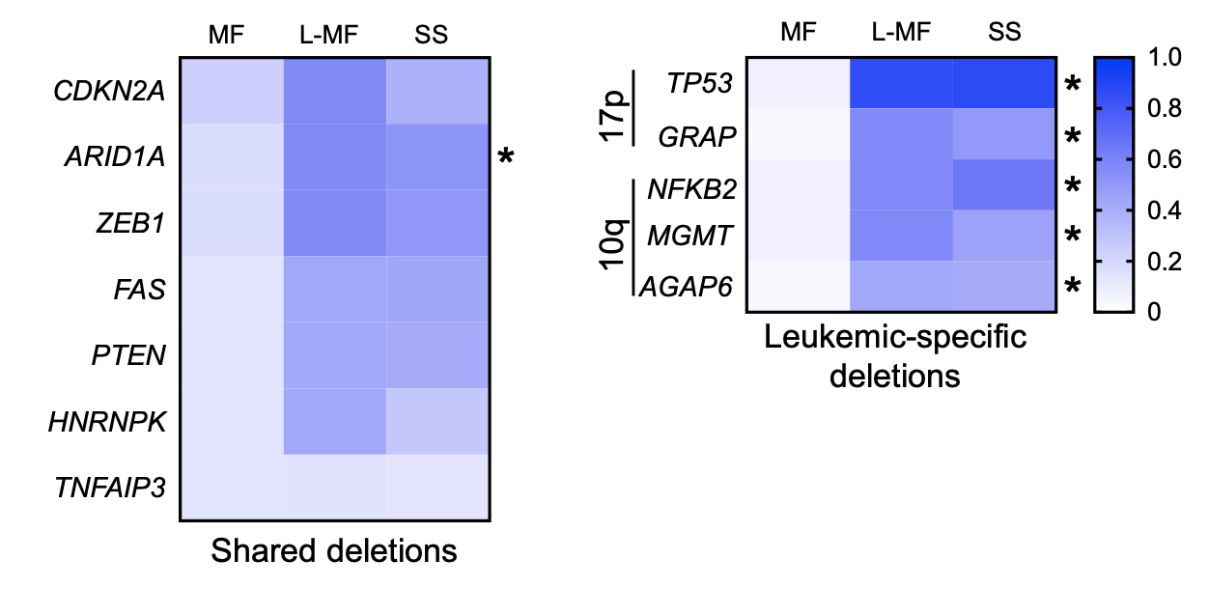
Though many driver gene deletions are shared, several located on broad CNVs are leukemic-specific

Slide 12
Model for genetic alterations across CTCL subtypes

Slide 13
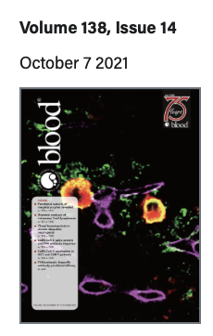
Conclusions and future directions
SS shows UV mutational signatures implying significant time tumor cells spent in the skin
Several driver gene mutations are shared between MF, L-MF, and SS, however leukemic samples develop highly recurrent CNVs
Is loss of 17p/gain of 17q required for skin limited tumor cells to invade the blood?
Could sampling longitudinally in patients with L-MF clarify whether leukemic disease coincides with de novo chr 17 alterations?
Does the UV signature in SS imply that it could originate from a skin resident cell, or otherwise a cell consistently recirculating between skin and blood?
More details:
Last week’s issue of Blood

Slide 14
Acknowledgements
Northwestern University
Funding
Joonhee Park
My mentor: Jae Choi
NU CTCL team:
Joan Guitart
Barbara Pro
Maria E. Martinez Escala
Jeffrey Sosman
Choi lab
Kim Ringbloom
Sara Choi
Jingyi Yang
Jane Thomas
Caroline Snowden
Katie Lee
Calvin Law
Yujin Lee
NIH/NCI T32CA09560
NIH/NCI F30CA265107
All patients and their families
Notes:
Thanks to everyone who contributed to this project, including the patients and all their families, and my funding sources.

Slide 15
Thanks for your attention! Questions?
Notes:
Thanks to everyone who contributed to this project, including the patients and all their families, and my funding sources.

