Slide 1
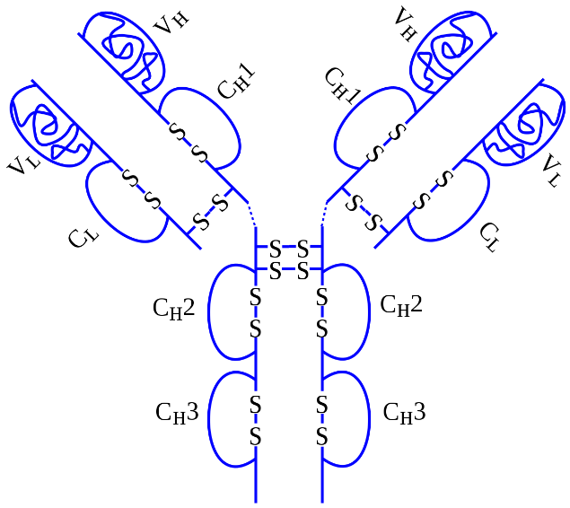
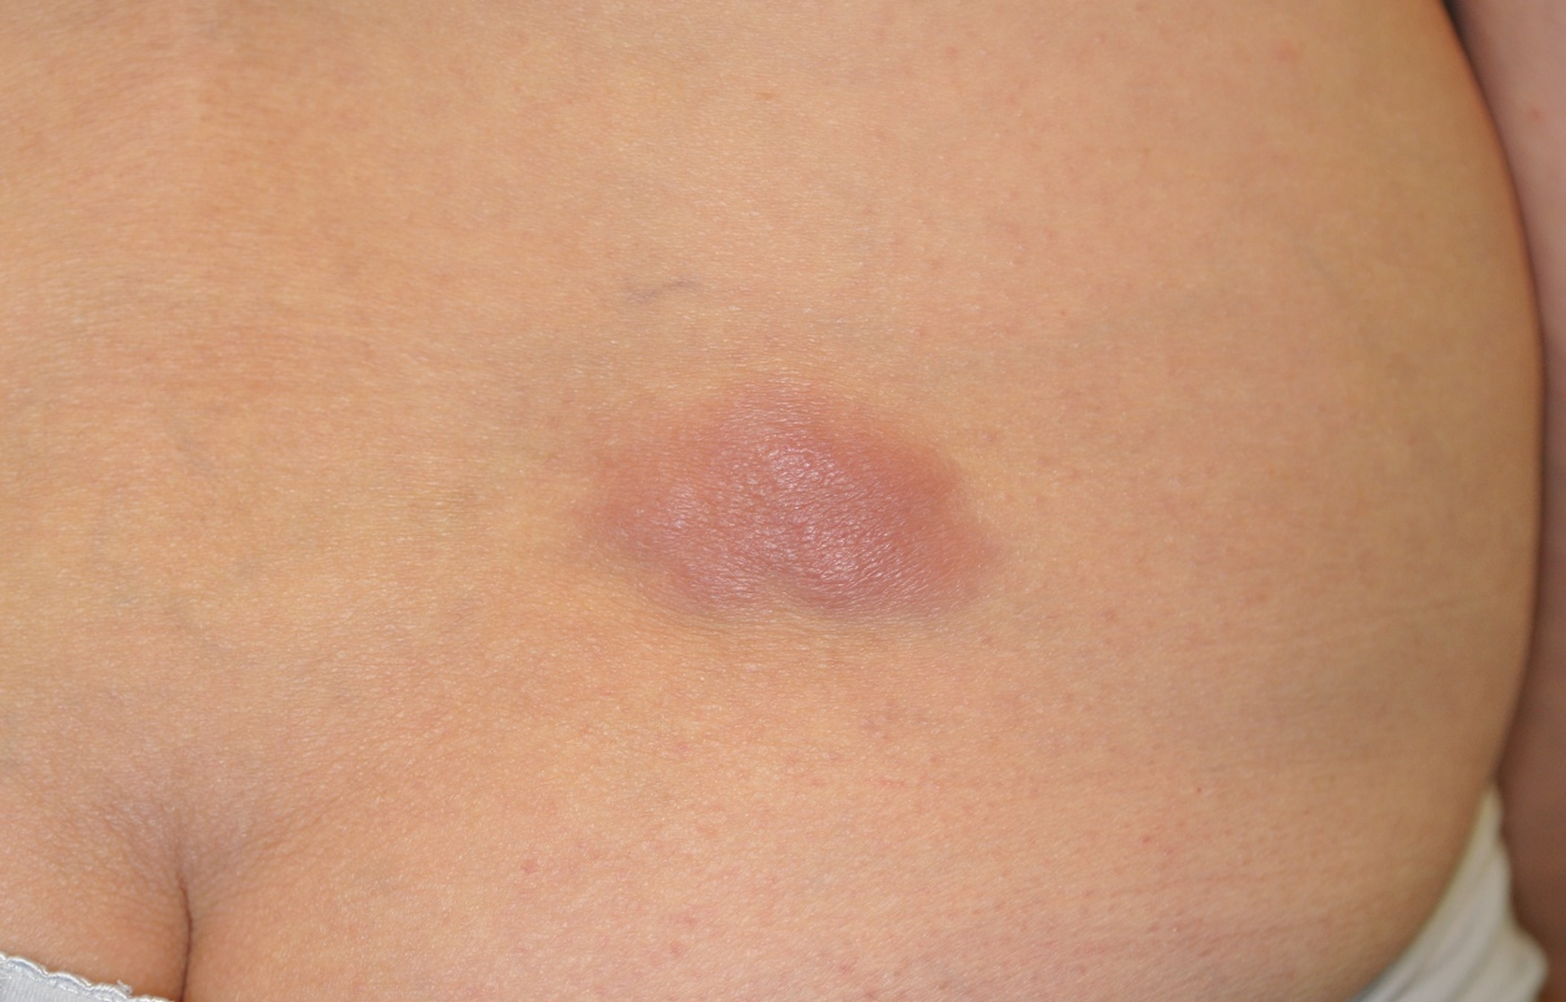
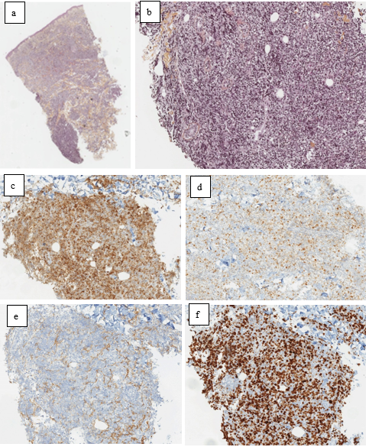
Primary cutaneous B-cell lymphoma leg-type (PCBCL-LT) related to a TNF-alpha inhibitor
S. Belkaïd¹, B. Balme², O. Harou², J. Le Borgne de Lavillandre¹, C. Wirbel¹, S. Dalle³, F. Grange¹
¹. Dermatology Department, Centre Hospitalier de Valence, Valence, France
². Anatomopathological Department, Hospices Civils de Lyon, Hôpital Lyon Sud, Pierre-Bénite, France
³. Dermatology Department, Hospices Civils de Lyon, Hôpital Lyon Sud, Pierre-Bénite, France
Tumor necrosis factor alpha inhibitors (TNFi) : efficacy in many inflammatory disorders
Debated risk of neoplasia, including lymphoproliferations
Rare cases of non-Hodgkin lymphoma, including exceptional cases of primary cutaneous lymphomas (PCL)
= mainly progression under TNFi of cutaneous T-cell lymphomas initially misdiagnosed as psoriasis or eczema ¹
63-year-old woman followed for an HLA-B27 positive spondylarthritis.
Treated with oral methotrexate 10 mg per week for 8 years
Adjunction of adalimumab 6 months earlier
1-month history of rapidly growing lumbar cutaneous lesion
6x4 cm solitary thick, violaceous plaque, no lymph nodes, fatigue, fever or pruritus.
(a;b) Dense monomorphic dermal proliferation of large cells with round nuclei. HES
(c) Positive Bcl2 staining (90%)
(d) Positive MUM1 staining (40%)
(e) Negative CD10
(f) Positive Ki67 staining (95%)
Additional test :
FDG-PET/CT : single cutaneous
hypermetabolic activity , no distant
tumors.
High resolution melting : MYD88 L265P mutation
PCR : monoclonal neoplastic B-cell population
FISH : negative EBV/EBER
Diagnosis of primary cutaneous B-cell lymphoma leg-type
Adalimumab (but not methotrexate) was discontinued : complete disappearance within 4 months
No other TNFi were later given. No recurrence was observed after a follow-up time of 4 years.
Drug-induced primary cutaneous B lymphoma (PCBCL)
TNFi : Rare indolent type PCBCL^{1,2}
Organ-transplant recipients : Reported cases of PCBCL-LT³
Methotrexate: cutaneous large B-cell lymphomas, sometimes morphologically and immunophenotypically similar to PCBCL-LT but with frequent EBV expression⁴
First case of PCBCL-LT induced by a TNFi : Typical histological and genetic features, including the monomorphic proliferation of large CD20+, Bcl2+, Mum1+, CD10-, centroblastic-like B cells, with B-cell clonality and the MYD88 L265P mutation⁵
PCBCL-LT : mostly aggressive, with frequent extracutaneous dissemination. Exceptional spontaneous regressions, constantly followed by recurrences⁶
Long-term remission after adalimumab discontinuation is a strong argument of the drug accountability
Martinez-Escala ME, et al. Progression of undiagnosed cutaneous lymphoma after anti-tumor necrosis factor-alpha therapy. J Am Acad Dermatol. 2018
Dequidt L et al. Cutaneous lymphomas appearing during treatment with biologics: 44 cases from the French Study Group on Cutaneous Lymphomas and French Pharamcovigilance database. Br J Dermatol 2019
3. Zhao J, et al. Primary cutaneous diffuse large B-cell lymphoma (leg type) after renal allograft: case report and review of the literature. Int J Hematol. 2009
4. Koens L, et al. Methotrexate-associated B-cell lymphoproliferative disorders presenting in the skin: A clinicopathologic and immunophenotypical study of 10 cases. Am J Surg Pathol. 2014
5. Pham-Ledard A, et al. High frequency and clinical prognostic value of MYD88 L265P mutation in primary cutaneous diffuse large B-cell lymphoma, leg-type. JAMA Dermatol. 2014
6. Graham PM, et al. Spontaneous regression of primary cutaneous diffuse large B-cell lymphoma, leg type with significant T-cell immune response. JAAD Case Rep [Internet]. 2018

