Slide 1
Experience of a supra-regional cutaneous lymphoma centre during the COVID-19 pandemic
Presented on Behalf of Prof. Julia Scarisbrick
U. Nguyen, K. Molloy, S.Z. Jaulim, F. Shah, J. Yoo, J.J. Scarisbrick
Department of Dermatology, Queen Elizabeth Hospital Birmingham, Birmingham, U.K.

Slide 2
Background:
COVID-19 was declared a pandemic on March 11th 2020.
Prioritisation of medical resources has had a major impact on dermatology services.
The consequences of the pandemic on the care of patients with primary CL in the U.K is unknown.
Aim:
To examine the impact of the COVID-19 pandemic on the care of individuals with cutaneous lymphoma.

Slide 3
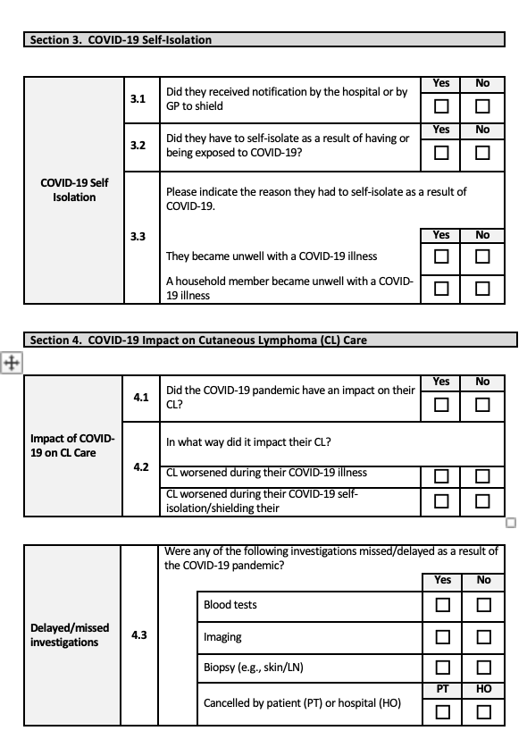
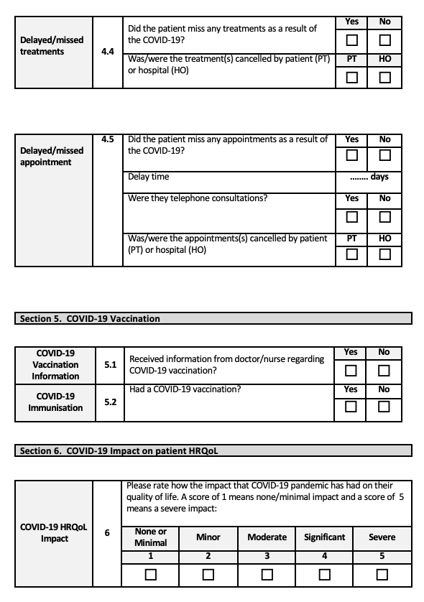
Methods:
Study visit data was analysed in 75 patients that were under the care of our centre as part of the PROCLIPI Study at UHB
Outpatient activities were recorded from Jan to Dec 2020
A specific COVID-19 dataset was developed to capture its impact on patients and completed by patients via telephone interview.
Pre-COVID clinical stage mSWAT score prior to and 4.5 (4.0-5.6) months after the onset of the pandemic were compared.

Slide 4
About us: Tertiary referral center in the UK 500 skin lymphoma patients under follow - up
MDT team lead by Prof. Julia Scarisbrick, 3 dermatologist consultants, 2 specialist nurses, 3 research nurses, 3 hematologist consultants, 2 clinical oncology consultants, 3 pathologists, 2 radiologists.

Slide 5
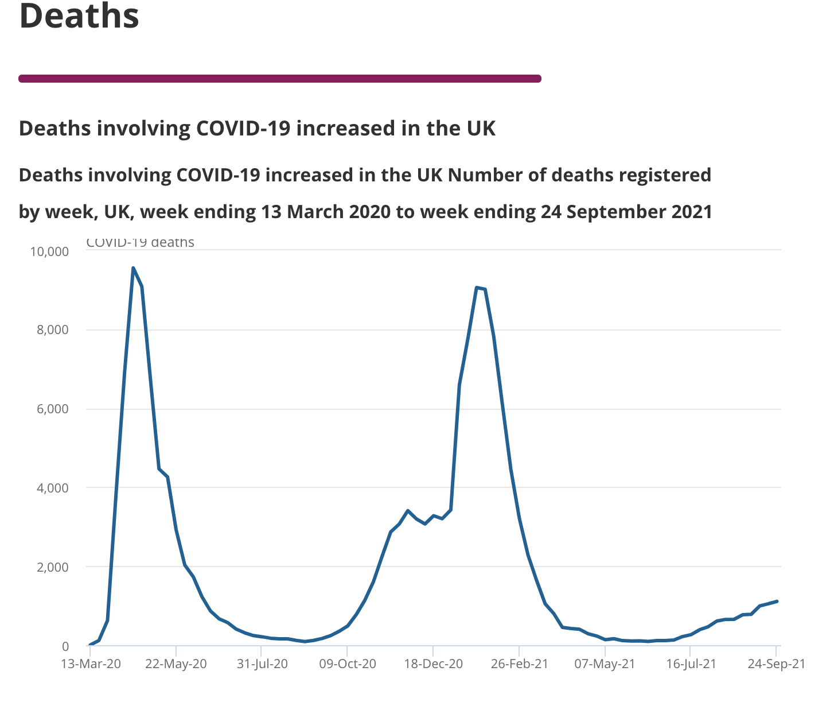
What happened in the UK in 2020
First full lockdown : 23rd Mar – 10th May 2020
10th May – 31 Oct 2020: Lockdown eased with social distancing restrictions
Second lockdown: 1st November to 2nd December

Slide 6
Impact on the service
From April to May 2020:
All CL dermatology consultants were re-deployed
Both CL clinical nurse specialists were re-deployed
All face-to-face CL treatments were canceled during the first lockdown from April to May 2020
From June 2020 to Dec 2020
Social distancing measures restriction to 5 patients per F2F clinic

Slide 7
Impact of patients- COVID-19 illness rate in 2020
 | Total No. of patients | Had Covid-19 infection | Death
Early-stage disease | 61 (81%) | 5 (6.7%) | 0
Late-stage disease | 14 (19%) | 0 | 1 (1.3%)
75 patients
Mean age of 65.19 years
Male:female ratio of 1.4:1
61 patients had early-stage disease
(IA, n=41; IB, n=17 and IIA, n=3)
14 had late-stage disease
(IIB, n=3; IIIA, n=4; IIIB, n=1; IVA1, n=3 and IVA2, n=3)

Slide 8
Impact on the patients
Worsening skin disease progression:
Quality of Life:
40.6% patients rated the pandemic as having a moderate to severe impact on their QoL.
No quantitative differences in health-related quality of life (HRQoL) using skin-dex29
Delay in treatment:
100% of patients had their appointments cancelled
12 out of 75 (16%) patients missed their treatments over the pandemic.
median (IQR) mSWAT score increased from 7.25 (0.85-30.25) prior to 26.4 (2.6-41.78) at 4.5 months after the onset of the pandemic , p=0.08 .
Missed treatment | No. of patients
Phototherapy | 5
Topical treatment | 3
Clinical trial product | 2
Extracorporeal photopheresis | 1
Radiotherapy | 1

Slide 9
How does C-19 Pandemic Effect Patient Hospital Care?
Face to face appointments cancelled / reduced
Less patient monitoring, patient examination
Less intimacy, mask wearing, social distancing
Telemedicine
Reduced rapport with physician?
Shorter consultations
Less interactive with extended care team , CNS
Hospital based treatments stopped
Phototherapy
Clinical Trials Stopped, Paused
Patient Covid Infection
Patient Shielding
Patient Isolating

Slide 10
Conclusion:
Cohort 75 MF/SS patients
Patient treatment interrupted 16%
No mortality
Trend towards worsening skin mSWAT
No worsening of HRQOL
Lessons learnt for future pandemics
Continue treatments where benefits out weigh risks
Shield vulnerable but not at detriment of patients health / well being

