Slide 1
EORTC CLTF meeting 20-21
Marseille │14.10.2021
Antibody-dependent cellular cytotoxicity and response to Extracorporeal photopheresis in Sézary syndrome
Iselin Christoph
Iselin C, Chang YT, Schlaepfer T, Fassnacht C, Dimitriou F, Nägeli M, Pascolo S, Hoetzenecker W, Bobrowicz M, Guenova E.

Slide 2
Discloser
Travel expenses and fees for EORTC 2021 were covered by Recordati
Iselin Christoph

Slide 3
Primary cutaneous T-cell lymphoma
Epidemiology
MF/SS
CD30+ LPD
Rare CTCL
Unclassified/NOS
ATLL
changing trends and geographic clustering^{2,5,6}
North America^{1,4,5,6}
South America¹
Europe^{1,2,3}
Asia¹
1. Dobos, G., et a.. (2020). Cancers (Basel) 12.; 2. Dobos, G., et al. (2020). Br J Dermatol. [online, ahead of print]; 3. Ottevanger, R., et al. (2021). Br J Dermatol; 4. Dores, G.M., et al. (2005). J Clin Oncol 23, 7246-7248.; 5. Ghazawi, F.M., et al. (2017).. Cancer 123, 3550-3567.; 6. Litvinov, I.V., et al. (2015). Cancer Med 4, 1440-1447.
Iselin Christoph

Slide 4
Sézary syndrome
Cutaneous T-cell Lymphoma
Dai J et al. JAMA Dermatol. 2017;153(6):620.
Iselin Christoph

Slide 5
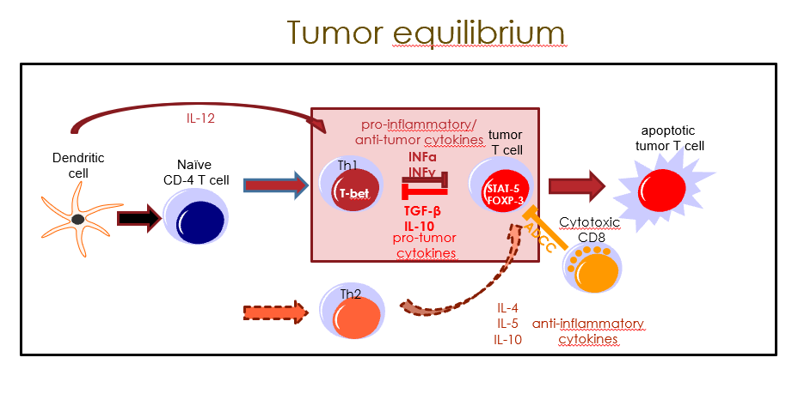
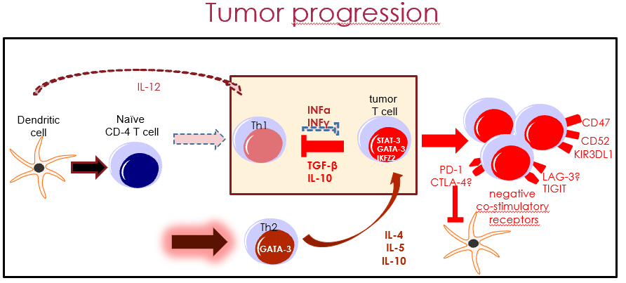
Cutaneous T cell lymphoma
Immune abnormalities
Tumor equilibrium
Tumor progression
1. Bobrowicz et al. (2020). Int Arch Allergy Immunol. 2020;181(10):733-745.
Iselin Christoph

Slide 6
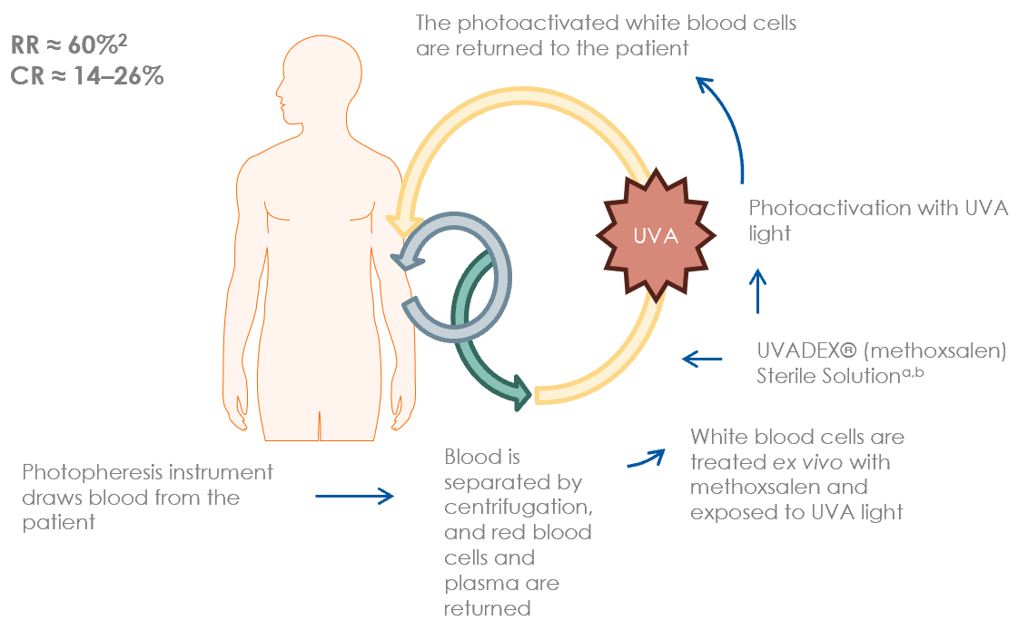
ECP: first line treatment¹
Sézary syndrome
Predictors of response?
1. Trautinger, F., et al. Eur J Cancer 2017 77: 57-74; 2. Knobler R et al. J Eur Acad Dermatol. 2020; 3. Alfred A et al. Br J Haematol. 2017;177(2):287–310.
Iselin Christoph

Slide 7
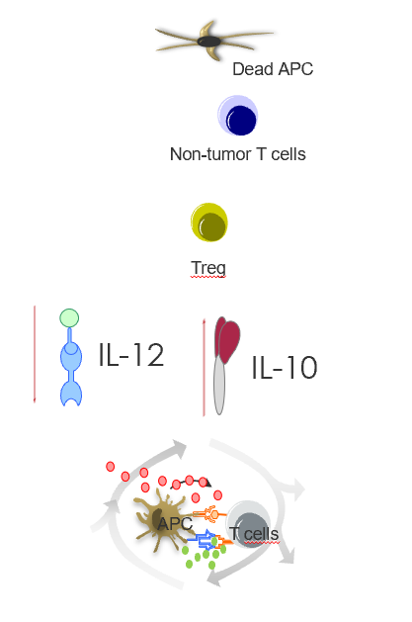
Extracorporeal photopheresis
Observations regarding mode of action
Damaged DC → T_{REG} ; apoptosis
IL-1 and integrin signaling pathways ↑
CD14+ monocytes → T cell proliferation
CD71 as surrogate for T cell proliferation ↓
Neutrophils dampen APC activation
Plus IL-2 for GvHD
Antigen-specific T- & B-cell responses ≈
NK cells numbers and function ↑
1. Ying Z, et al. Oncotarget. 2019;10(34):3183-97; 2.Wiese F, et al. Clin Exp Immunol. 2019;195(3):369-80.; 3. Schwab L, et al. Vox Sang. 2019.; 4.Ni M, et al. Front Immunol. 2019;10:547.; 5. Franklin C, et al. J Leukoc Biol. 2019;106(2):481-93.; 6. Belizaire Ret al. Blood Adv. 2019;3(7):969-79.; 7. Wang L, et al. Front Immunol. 2018;9:2207.; 8. Apostolova P. et al. (2020) New Engl J Med. 382(3):294-296.
Iselin Christoph

Slide 8
Extracorporeal photopheresis
Observations regarding mode of action
Damaged DC → T_{REG} ; apoptosis
IL-1 and integrin signaling pathways ↑
CD14+ monocytes → T cell proliferation
CD71 as surrogate for T cell proliferation ↓
Neutrophils dampen APC activation
Plus IL-2 for GvHD
Antigen-specific T- & B-cell responses ≈
NK CELLS NUMBERS AND FUNCTION ↑
1. Ying Z, et al. Oncotarget. 2019;10(34):3183-97; 2.Wiese F, et al. Clin Exp Immunol. 2019;195(3):369-80.; 3. Schwab L, et al. Vox Sang. 2019.; 4.Ni M, et al. Front Immunol. 2019;10:547.; 5. Franklin C, et al. J Leukoc Biol. 2019;106(2):481-93.; 6. Belizaire Ret al. Blood Adv. 2019;3(7):969-79.; 7. Wang L, et al. Front Immunol. 2018;9:2207.; 8. Apostolova P. et al. (2020) New Engl J Med. 382(3):294-296.
Iselin Christoph

Slide 9
Cohort study design
role of NK cells in ECP for SS?
2012
2019
SS patients starting ECP
13 SS newly diagnosed patients (1 drop out)
ECP first-line monotherapy
Average uninterrupted treatment duration: 9 months
Blood sample collection t0 (70%), t_{median}-2.5 30%), t_{median}+6.75 (60%)
Iselin C. et al. (2021) Oncoimmunology. 10(1):1873530.
Iselin Christoph

Slide 10
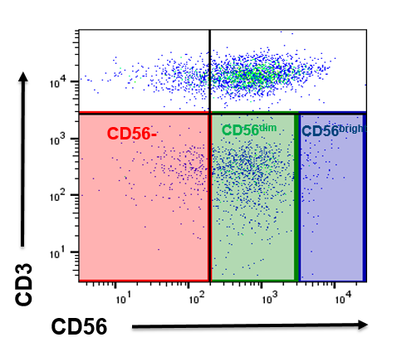
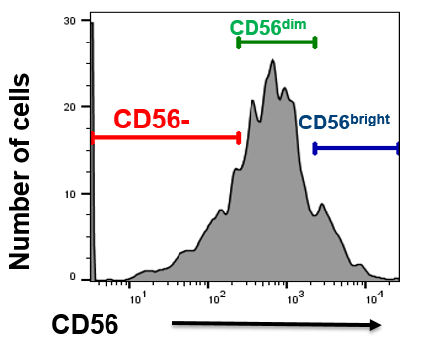
Natural killer cells
↓ in SS patients compared to healthy individuals
Healthy SS donor
Iselin C. et al. (2021) Oncoimmunology. 10(1):1873530.
Iselin Christoph

Slide 11
Natural killer cells
Tendency to recover after ECP treatment
before ECP after ECP
before ECP after ECP
before ECP after ECP
Related to treatment response?
Iselin C. et al. (2021) Oncoimmunology. 10(1):1873530.
Iselin Christoph

Slide 12
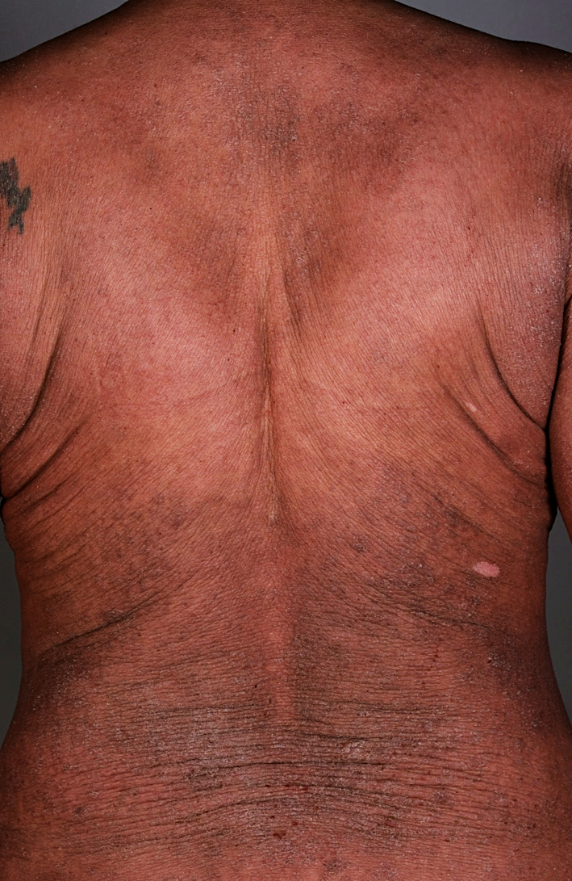
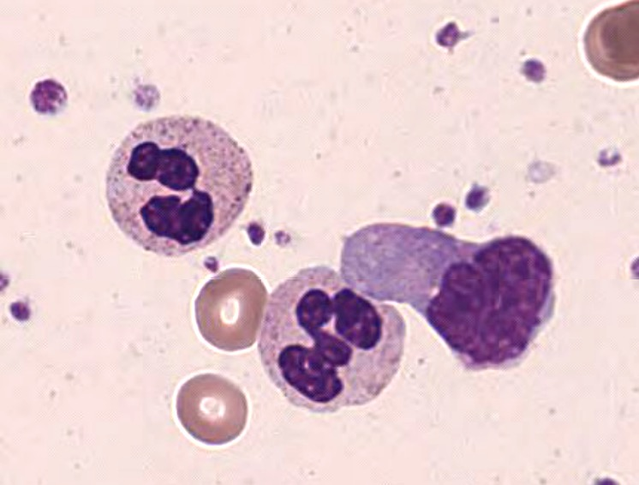
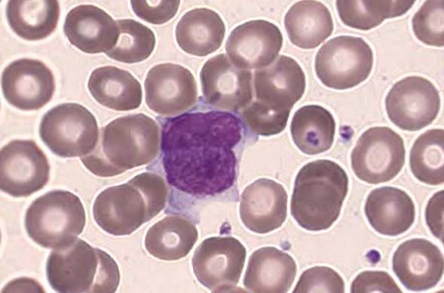
Sézary syndrome
Definition
International Society for Cutaneous Lymphomas (ISCL)¹:
One or more of the following:
Sezary count > 1000 cells/mm3 (FACS)
Increased lymphocyte counts + immunophenotypical abnormalities : CD4/CD8 ratio > 10 and/or loss of one or more T-cell antigens (CD2, 3, 4, 5, 7, 26)
Demonstration of T-cell clonality in the blood
Response criteria
CR: B0
PR: reduction of >50% in B2
PD: increase of >50% AND >5000 neoplast. cells /μl
SC: not CR/PR/PD
WHO–EORTC classification for cutaneous lymphomas²:
T-cell clonality (ideally blood + skin) + one of the above
Current EORTC proposal*³:
Sezary count > 1000 cells/mm3 (FACS)
B0<250/µL
B1≥250/µL and <1000/µ
*Historical: B0≤5%, B1>5% and <1000, B2 ≥ 1000 Sézary cells per µL blood
1. Vonderheid, E. C., et al. (2002). J Am Acad Dermatol 46(1): 95-106.; 2. Willemze, R., et al. (2005). Blood 105(10): 3768-3785.; 3. Scarisbrick, J. J., et al. (2018). Eur J Cancer 93: 47-56; 4. 2. Olsen, E., et al. (2007). Blood 110(6): 1713-1722
Iselin Christoph

Slide 13
Treatment responders
CR=B0 (<250 cell/ µL) ; PR: >50% ↓; PD: >50% ↑; SD≠CR ∪ PR ∪ PD
SS patients starting ECP
Response to treatment
ORR 33%
t0
t_{median}6.75
Iselin C. et al. (2021) Oncoimmunology. 10(1):1873530.
Iselin Christoph

Slide 14
Natural killer cells recovery
in this study not associated with the treatment response
Iselin C. et al. (2021) Oncoimmunology. 10(1):1873530.
Iselin Christoph

Slide 15
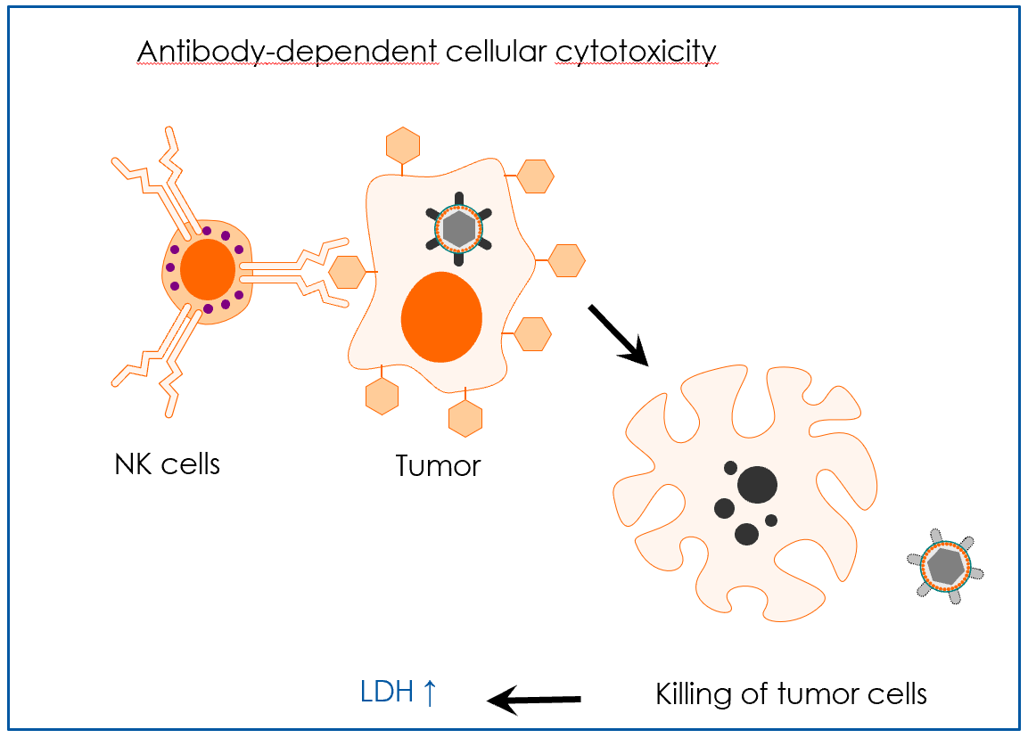
Extracorporeal photopheresis
OBSERVATIONS REGARDING MODE OF ACTION
Damaged DC → T_{REG} ; apoptosis
IL-1 and integrin signaling pathways ↑
CD14+ monocytes → T cell proliferation
CD71 as surrogate for T cell proliferation ↓
Neutrophils dampen APC activation
Plus IL-2 for GvHD
Antigen-specific T- & B-cell responses ≈
NK CELLS NUMBERS AND FUNCTION ↑
1. Ying Z, et al. Oncotarget. 2019;10(34):3183-97; 2.Wiese F, et al. Clin Exp Immunol. 2019;195(3):369-80.; 3. Schwab L, et al. Vox Sang. 2019.; 4.Ni M, et al. Front Immunol. 2019;10:547.; 5. Franklin C, et al. J Leukoc Biol. 2019;106(2):481-93.; 6. Belizaire Ret al. Blood Adv. 2019;3(7):969-79.; 7. Wang L, et al. Front Immunol. 2018;9:2207.; 8. Apostolova P. et al. (2020) New Engl J Med. 382(3):294-296.
Iselin Christoph

Slide 16
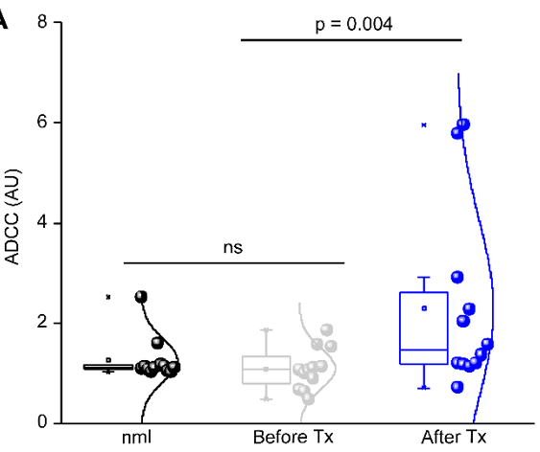
Natural killer cells function
Is selectively enhanced in SS responders to ECP
Iselin C. et al. (2021) Oncoimmunology. 10(1):1873530.
Iselin Christoph

Slide 17
ECP for Colitis Induced by Checkpoint-Inhibitor Therapy
Also relies on NK cell activity¹
29-year-old man
1. Apostolova P. et al. (2020) New Engl J Med. 382(3):294-296.
Iselin Christoph

Slide 18
SUMMARY
↑ ADCC is associated with response to ECP in SS
NK cell numbers ↓ in SS patients
compared to healthy controls
Tendency of ECP-related recovery of NK cells numbers
not associated with treatment response
NK cell activity (ADCC) ↑ in ECP responders
maybe a reliable biomarker to monitor response to treatment in SS
Iselin C. et al. (2021) Oncoimmunology. 10(1):1873530.
Iselin Christoph

Slide 19
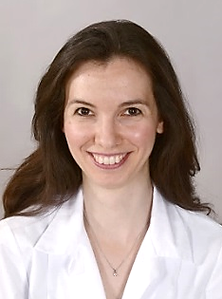
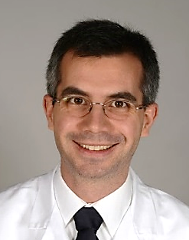
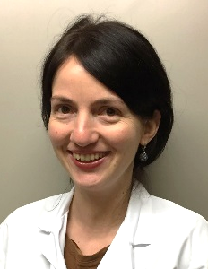
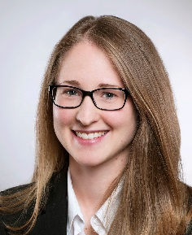
EORTC CLTF meeting 20-21
Marseille │14.10.2021
Acknowledgements
Yun-Tsan Chang
Emmanuella
Guenova
Wolfram
Hoetzenecker
Desislava
Ignatova
Christina
Fassnacht
Iselin Christoph
THANK YOU!
christoph.iselin@bluewin.ch

