Slide 1
Functional Remodeling of Macrophages with
anti-PD-L1 and Lenalidomide in Cutaneous T Cell Lymphoma
Abstract ID: 31
Zhen Han, Ching-Yu Su, Xiwei Wu, Hanjun Qin, Jasmine Zain, Steven T. Rosen, Christiane Querfeld
~
EORTC CLTF Meeting Marseille, Oct 15, 2021
Category: O2-04

Slide 2
Disclosures
Steering Committee/Advisory Board
  Helsinn, Bioniz, MiRagen, Kyowa Kirin, Trillium Therapeutics
Investigator
  Celgene (Bristol Myers Squibb), Helsinn, Kyowa Kirin, Esai, Bioniz, MiRagen, Trillium Therapeutics
Speakers Bureau
  Helsinn
Funds/Research Grants
  Celgene

Slide 3
Background
M2-like tumor-associated macrophages (TAMs) are the most abundant phenotype that promote the growth of cutaneous T cell lymphoma (CTCL) by inducing immunosuppression
Depletion of M2-like TAMs delays CTCL development, but little is known about PD1+M2-TAM phenotypes
Understanding the mechanisms of macrophage reprogramming will identify novel therapeutic targets to reverse impaired immunity

Slide 4
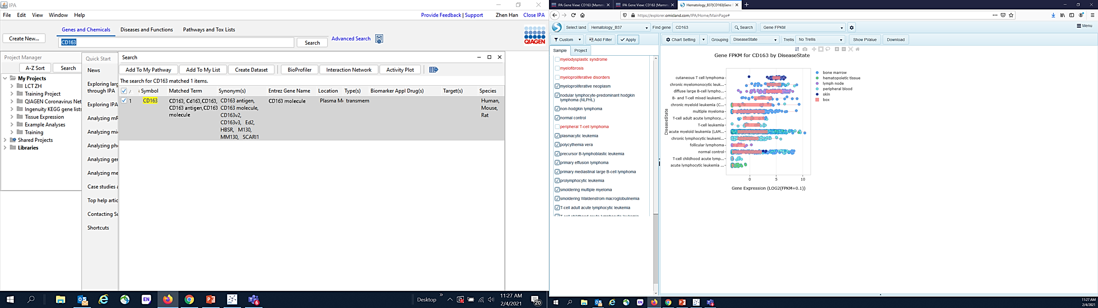
Tumor-Associated Macrophages are the Most Abundant Immune Cell Phenotype in CTCL
N=47 CTCL samples
****

Slide 5
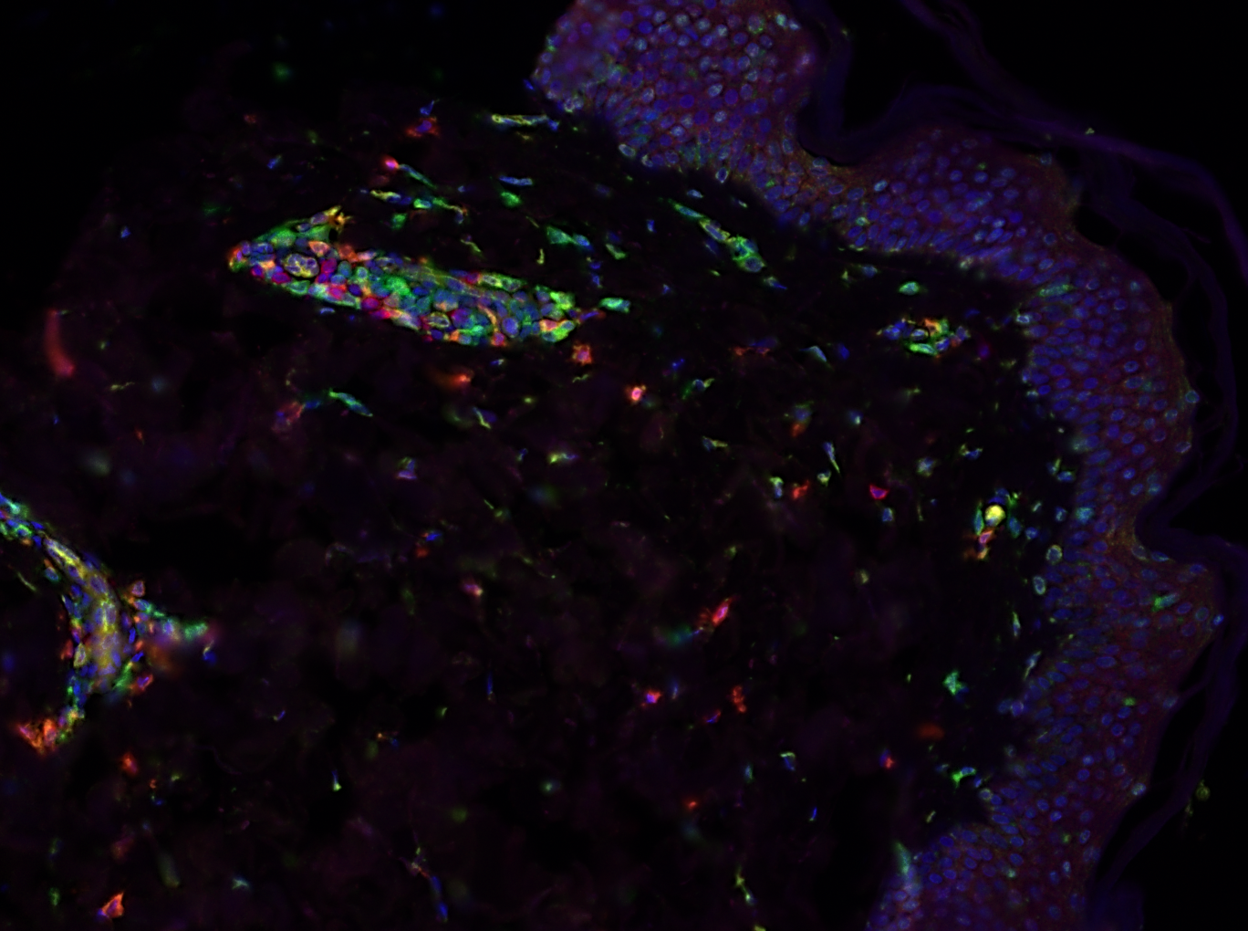
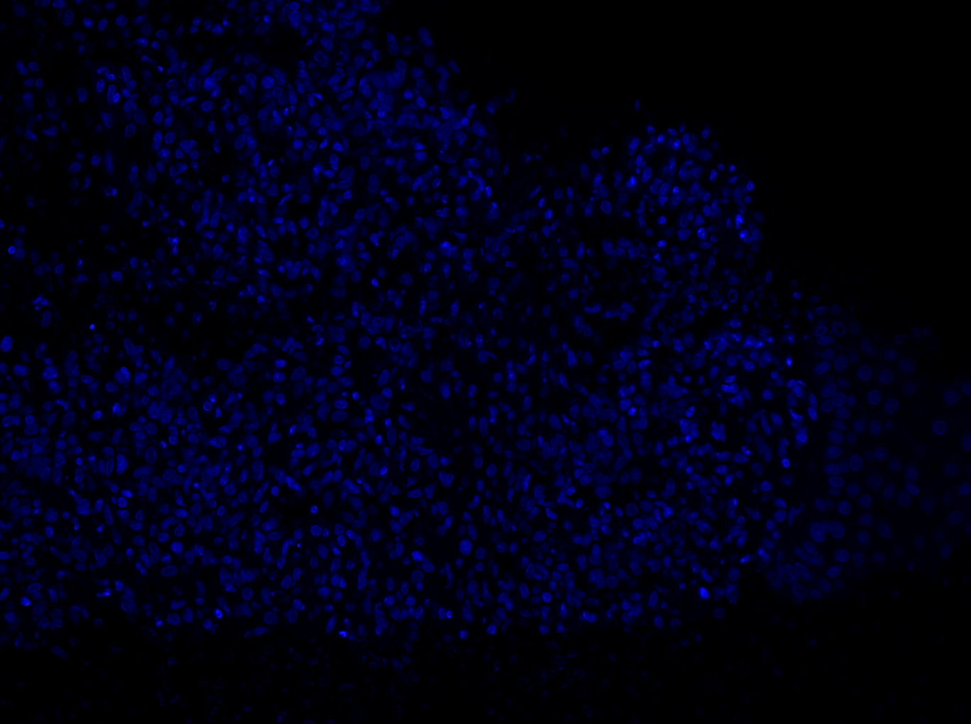
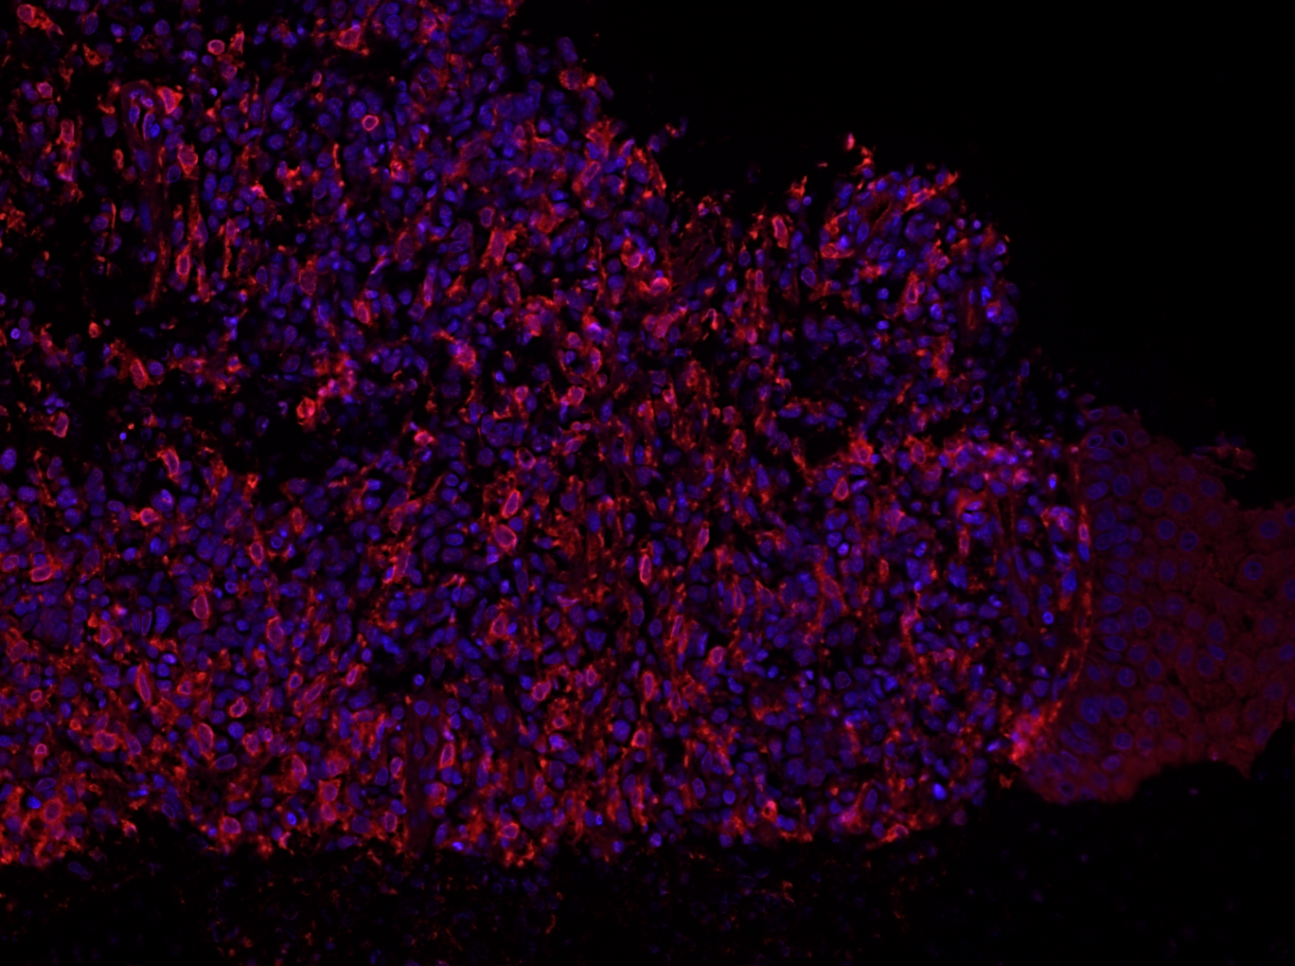
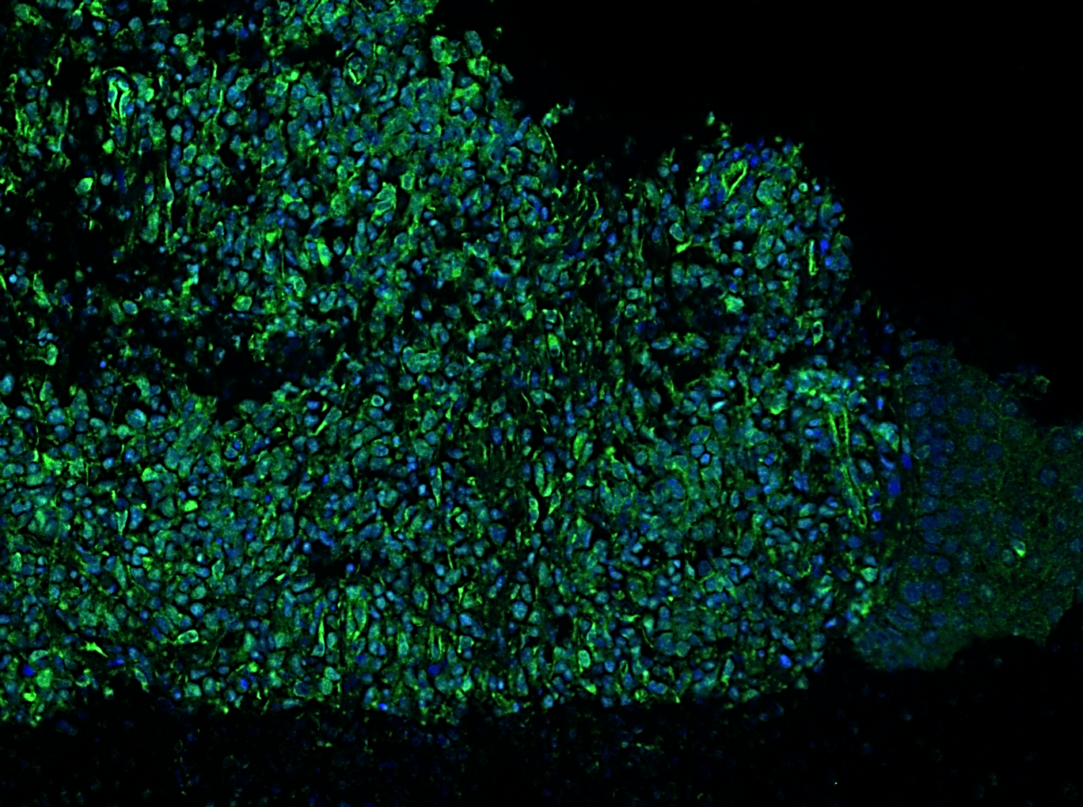
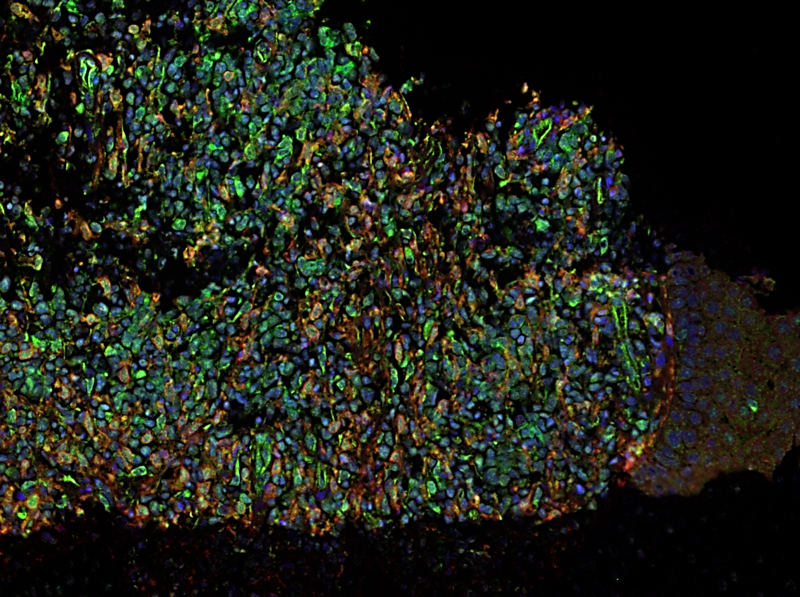
The PD1+ M2-like TAMs Accumulate in Lesional Skin of CTCL Patients
DAPI
CD163+
PD1+
CD163+PD1+
Healthy Donor
CTCL

Slide 6
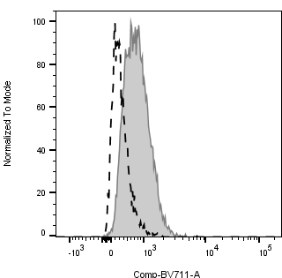
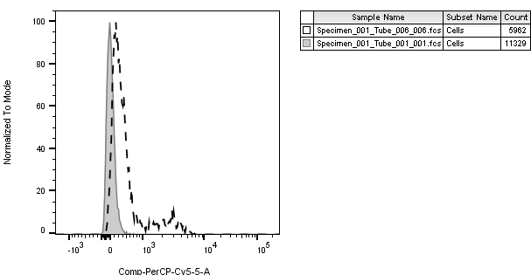
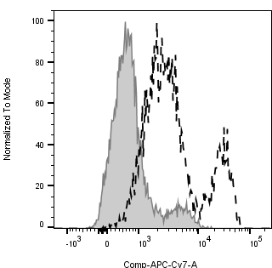
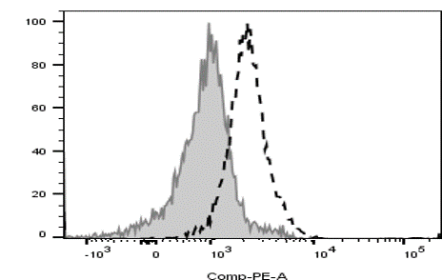
Tumorigenic Cytokines Secreted by MyLa Cells Polarize Macrophage Differentiation towards PD1+ M2-like phenotype
CD80
CD163
CD206
PD1
Count
****
**
***
**

Slide 7
















NF-κB and JAK/STAT signaling correlates with M2 TAM phenotype
Ctrl CM
Ctrl CM
pIKKα/β
JAK3
IKKα
STAT1
IKKβ
pSTAT3
pIKBα
STAT5
IKBα
STAT6
pNF-κB
SOCS2
NF-κB
SOCS6
GAPDH
GAPDH
TAMs cultured in MyLa-derived conditioned medium
Stage | MF/SS (n = 48)
Healthy | 3
T1 | 7
T2 | 16
T3 | 18
T4 | 4

Slide 8
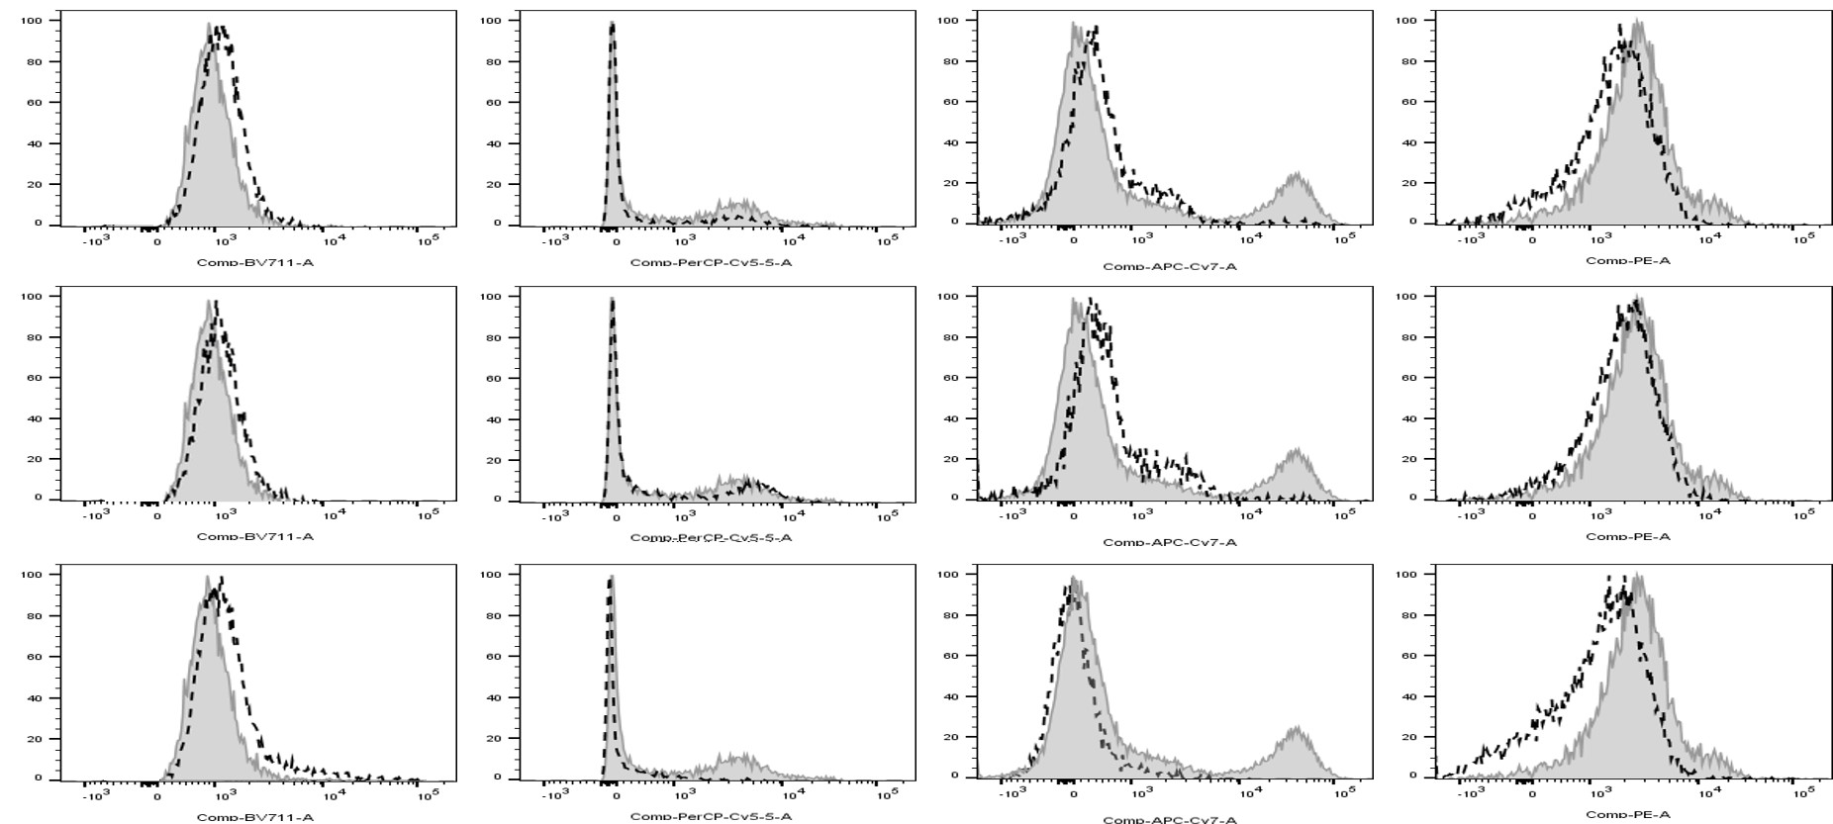
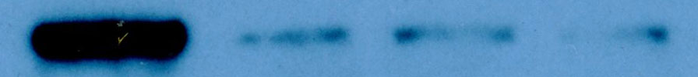
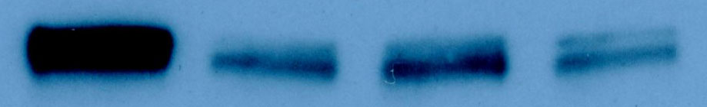


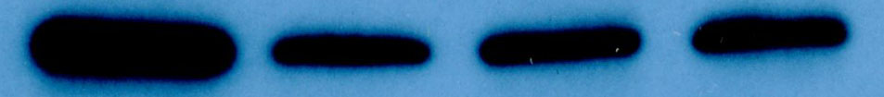
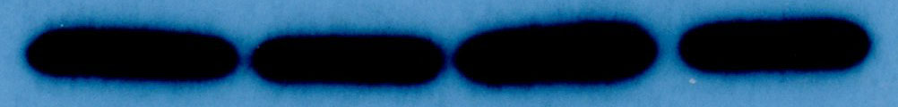
Anti-PD-L1 and Lenalidomide Reprogram M2-like TAMs to M1 by Downregulation of NF-κB and JAK/STAT Signaling Pathways
****
****
****
****
****
****
****
****
****
***
***
aPD-L1/
Len
CD80
CD163
CD206
PD1
CM
aPD-L1
Len
JAK3
aPD-L1
STAT1
pSTAT3
STAT5
Len
STAT6
pNF-κB
aPD-L1/
Len
NF-κB
GAPDH
Notes:
aPD-L1 and Lenalidomide treatment dramatic increased IL-1β, CXCL-10, and CXCL-11 expression, but significantly decreased IL-10 level compared with the untreated control (Figure 3A). Furthermore, aPD-L1 and Lenalidomide synergistically induced M1 macrophages related IL-1β, CXCL-10, and CXCL-11 expression and inhibited NF-κB and JAK/STAT signaling

Slide 9
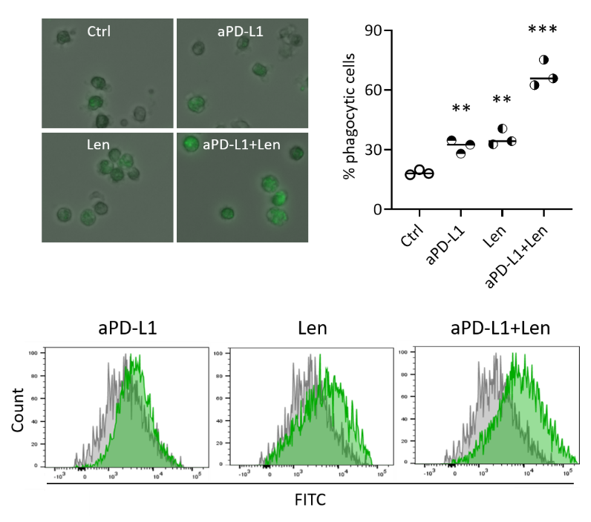
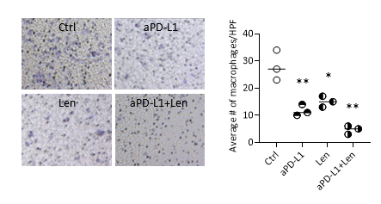
Anti-PD-L1 and Lenalidomide Induce Functional Changes in Phagocytic Activity and Cell Migration of TAMs
Phagocytosis assays
Cell migration

Slide 10
Conclusions
The microenvironment plays a profound role in CTCL progression
NF-κB and JAK/STAT signaling may drive PD1+ M2-like TAMs phenotypes
Anti-PD-L1 and lenalidomide can synergistically reprogram PD1+ M2-like TAM to M1-like TAM phenotypes and induce functional changes through downregulation of NF-κB and JAK/STAT pathways

Slide 11






Acknowledgements
City of Hope
Steven Rosen
Larry Kwak
Steven Forman
Stan Hamilton
Christiane Querfeld lab
  Zhen Han
  Ching-Yu Su
Rosen Lab
Mingye Feng lab
Xiwei Wu
Tijana Talisman
James Sanchez
Joycelynne Palmer
Lu Chen
Peter Lee
Thank you to all our patients
Supported by:
NIH-NCI
Leukemia Lymphoma Society
Toni Stephenson Lymphoma Center
Israel Cancer Research Fund
Stop Cancer
Jasmine Zain
Farah Abdulla
Savita Dandapani
Chelsea Abad
Karen Huelsman
Xochiquetzal Martinez
Nicholas Trum
Linda Devine
Lilit Stepanyan
Yaira Kurzman
Lauren Seipel
Anna Medrano
Estella Barrios
Matt Loscalzo
Raju Pillai
Michelle Afkhami
MSKCC
James Young
Querfeld Lab
Clinical Team

