Slide 1
Recurrence of Cutaneous T-cell lymphoma (CTCL) post viral vector COVID-19 vaccination
Dr Evdoxia Panou
On behalf of:
Dr. Nikolaou V, Dr. Marinos L, Dr. Kallambou S, Dr Sidiropoulou P, Dr Gerochristou M, Prof. Stratigos A
Notes:
knkl

Slide 2
Introduction
COVID-19 pandemic is associated with a considerable number of fatal cases worldwide
Cancer patients seem to exhibit exacerbated conditions and a higher mortality rate
Vaccines are the promising solution to minimise the problem amongst cancer patients but there are limitations to be considered
We present two CTCL cases which were in remission for many years and the immunization with viral vector COVID-19 vaccine (Vaxzevria, Oxford/AstraZeneca) induced them to reappear

Slide 3
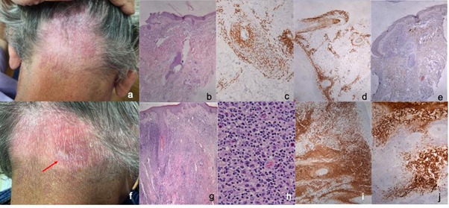
The first case: 60-year-old male with the diagnosis of folliculotropic MF, stage T1a
Alopecia areata like rash
On clinical remission the last two years, the disease was stage T1aN0M0 with only a patch of hair loss on the occipital area
A lichenoid induration four weeks after the first dose of the vaccine was observed
Small nodules were detected on the same location a week after the second dose
The diagnosis of CD30+ large cell transformation (LCT) tumor stage MF (Figure 1g-j) was set by immunohistochemistry and PCR analysis
Figure 1. Clinical presenttion and histology before (a-e) and after (f-j) the vaccine.
a) Purple patch on the occipital area b) H&E X 20: Lymphoid infiltration of the dermis with prominent folliculotropism, c) CD3X 40: CD3 expression d) CD4 X 20: CD4 expression e) CD30 X 20: Sparse CD30 positivity f) Lichenoid induration and small nodules on the periphery of the patch, g) H&E X 20: Dense, diffuse, full thickness lymphoid infiltration of the dermis, h) H&E X 400: Increased numbers of large neoplastic T-lymphocytes among the lymphocytic population i) CD3 X 20: CD3 expression, j) CD30 X 40: Extensive CD30 positivity mainly in the large anaplastic T- lymphocytes (transformation to peripheral CD30+ T-cell lymphoma)

Slide 4
The second case: 73-year-old female, with a ten-year history of early-stage MF (stage T1a/IA) and lymphomatoid papulosis type A (LyP)
Immunocytochemically and molecularly confirmed diagnoses
In remission the last seven years
Ten days after the first dose of the vaccine she developed a rash on thighs and abdomen (Figure 2 a&b)​
The histology confirmed the diagnosis of LyP type-A (Figure 2c-h).
Figure 2. Clinical presentation and histology after the vaccine.
a) Erythematous papules on the dorsal aspect of the thigh b) Erythematous papules and scaly plaques on the abdominal area c) H&E x 100 d) Diffuse H&E x 200: polymorphic infiltration of the reticular dermis by lymphocytes of various sizes (small to large anaplastic), e) CD30 x 100 f) CD30 x 200: CD30 expression by the majority of the lymphocytic population, g) CD4 x 100: Predominantly CD4 expression h) CD8 x 100: CD8 expression

Slide 5
Discussion
Via which pathway the vaccine has caused the MF large cell transformation and LyP?
CD4+ T, CD8+ T, and B cells against SARS-CoV-2 S protein is the most feasible strategy for Covid vaccine production
Both cancers and coronavirus provide a persistent and chronic antigenic load resulting in T-cell exhaustion
CD30 is expressed on a small subset of activated T and B lymphocytes, and a variety of lymphoid neoplasms
CD30 expression on lymphocytes could be induced by in vitro antigenic stimulation by mitogens or viruses
In our case, it was given a viral vector vaccine which does not include live viruses, however, contains a part of the coronavirus stuck to adenovirus which triggers an immune response

Slide 6
Conclusions
Speculation that the flare of the disease was possibly caused by overproduction and exhaustion of CD4+ and CD8+ cells which expressed CD30 after being triggered by the adenovirus
It is known that CD30 can be responsible for disease progression
Reappearance of a pre-existing neoplastic condition or lymphoproliferative disease post covid vaccination is extremely uncommon
Currently there is limited evidence in regards to the safety and efficacy of vaccines in patients with altered immunity
Further studies are needed for this target group of patients

