Slide 1
EORTC CLTF meeting 20-21
Marseille │15.10.2021
Increased chlormethine-induced DNA double-stranded breaks in malignant T cells from mycosis fungoides skin lesions
Yun-Tsan Chang, PhD
Chang Y.-T., D. Ignatova, W. Hoetzenecker,
S. Pascolo, C. Fassnacht, and E. Guenova

Slide 2
Mycosis Fungoides
Cutaneous T-cell Lymphoma (CTCL)
Patch
Plaque
Prognosis
Tumor
Yun-Tsan Chang, PhD

Slide 3
An akylating agent
(topical chemotherapy)
Chlormethine (CL)
Mechlorethamine
or
Nitrogen Mustard
CH₂-CH₂
CH₂-CH₂
N–CH₃
DNA
2 Cl⁻
Binding twice to one strand (intrastrand crosslink)
Cl-CH₂-CH₂
N–CH₃
Cl-CH₂-CH₂
CL
CH₂-CH₂
CH₂-CH₂
N–CH₃
Binding to both strands (interstrand crosslink)
National Comprehensive Cancer Network (NCCN); https://www.nccn.org/professionals/physician_gls/default.aspx.
Trautinger F, et al. Eur J Cancer. 2017;77:57–74.
Willemze R, et al. Ann Oncol. 2018;iv30–iv40.
Yun-Tsan Chang, PhD

Slide 4
Objective
The impact of chlormethine (CL) on malignant skin T cells regarding:
Treatment susceptibility (MTT assay)
Alkylated-nucleotide-excision gene expression (RT-qPCR)
DNA double-stranded breaks (γH2AX Ser139 expression by flow cytometry)
Proliferation (BrdU assay)
Chang YT et al. JID Innovations, 2021; accepted
Yun-Tsan Chang, PhD

Slide 5
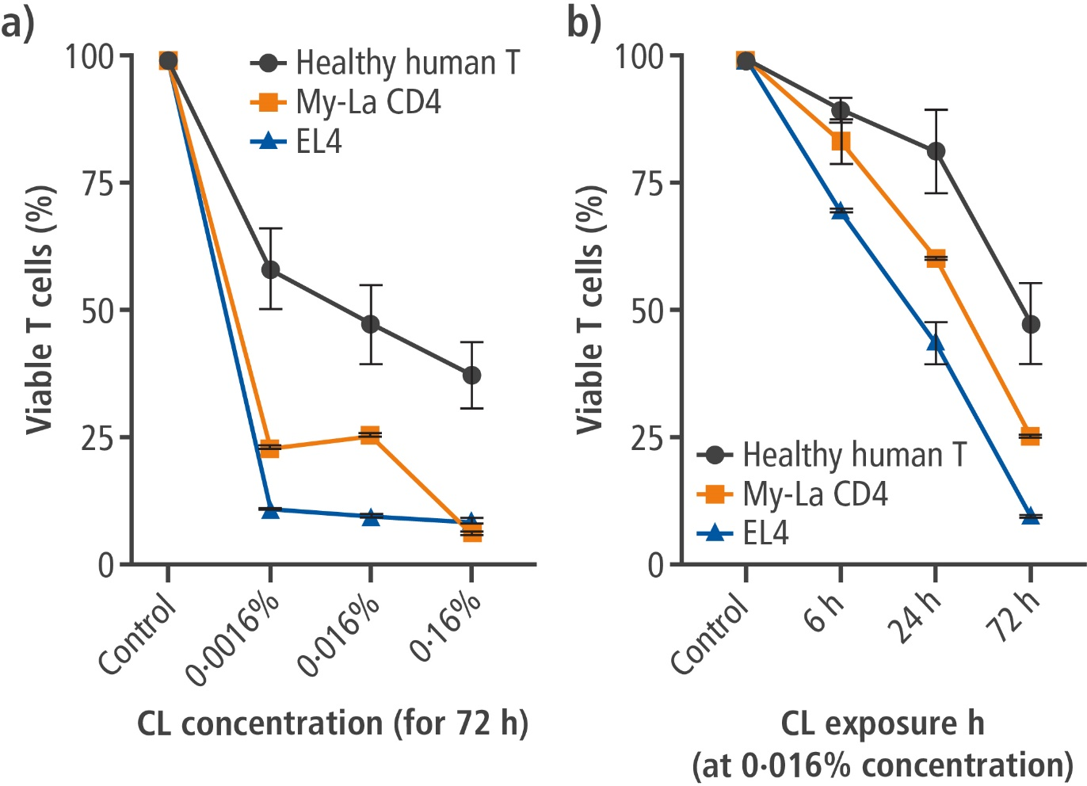
CL decreases T cell viability time- and dose-dependently
Chang YT et al. JID Innovations, 2021; accepted
Yun-Tsan Chang, PhD

Slide 6
MF skin T cells have reduced expression of DNA-repair pathways
Chang YT et al. JID Innovations, 2021; accepted
Yun-Tsan Chang, PhD

Slide 7
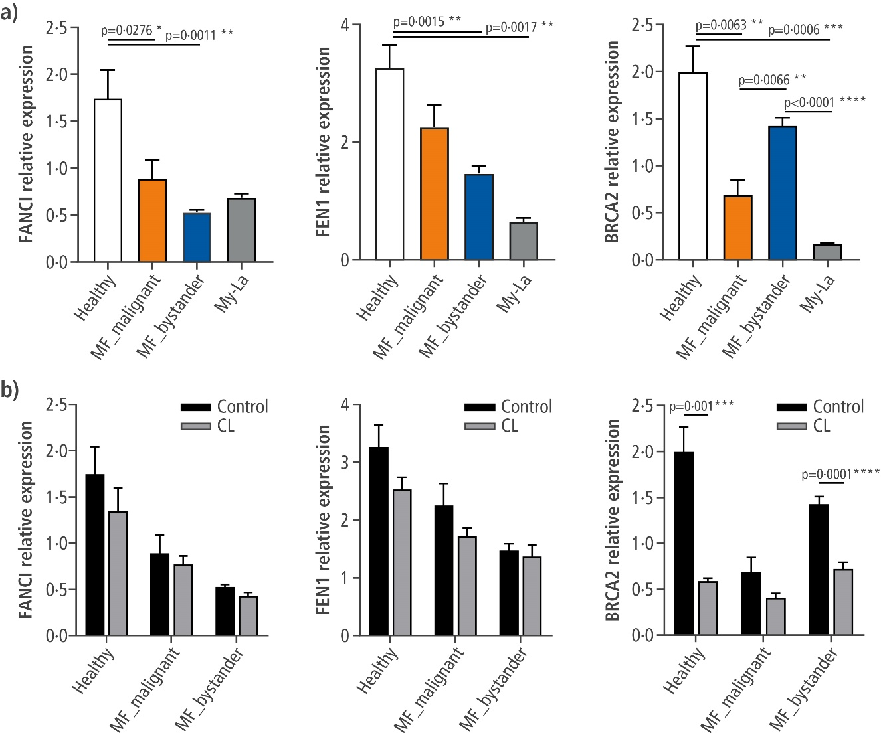
CL exposure further suppresses the expression of genes related to DNA repair in MF skin T cells, especially BRCA2
Chang YT et al. JID Innovations, 2021; accepted
Yun-Tsan Chang, PhD

Slide 8
Double-stranded DNA breaks in malignant MF skin T cells are increased in the presence of CL
Chang YT et al. JID Innovations, 2021; accepted
Yun-Tsan Chang, PhD

Slide 9
Proliferation of malignant T cells is not significantly influenced by CL
Chang YT et al. JID Innovations, 2021; accepted
Yun-Tsan Chang, PhD

Slide 10
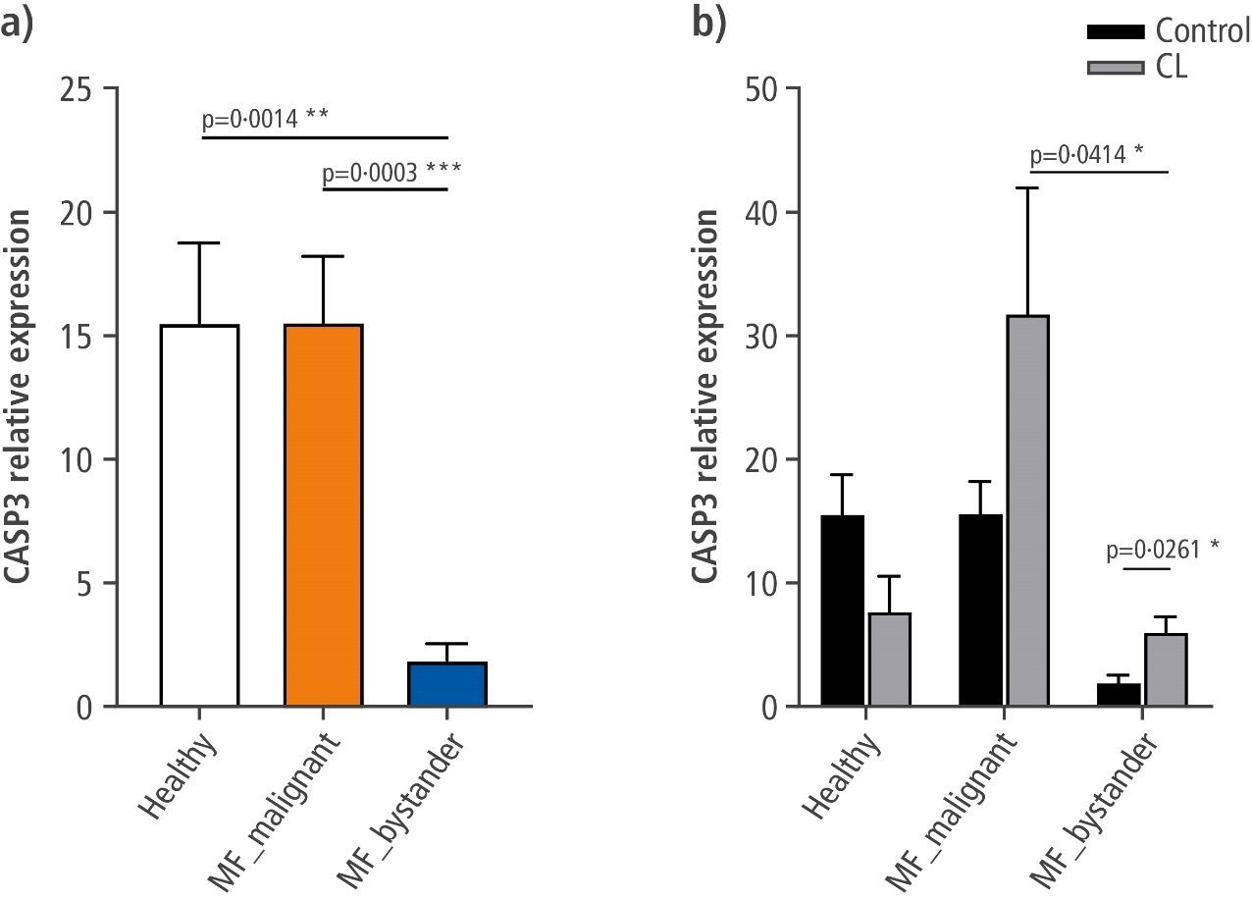
CL exposure increases expression of the apoptotic gene CASP3 predominately in malignant MF skin T cells
Chang YT et al. JID Innovations, 2021; accepted
Yun-Tsan Chang, PhD

Slide 11
SUMMARY
The anti-tumor effects of chlormethine on MF skin T cells
↑ DNA double-stranded breaks
in mycosis fungoides clonal malignant skin T cells
↑ The expression of CASP3
in the subpopulation of malignant skin T cells
↓ The expression of alkylated-nucleotide-excision genes
involved in DNA repair
Chang YT et al. JID Innovations, 2021; accepted
Yun-Tsan Chang, PhD

Slide 12
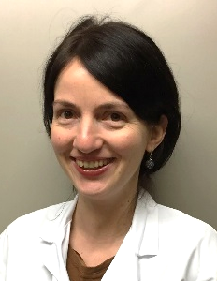
EORTC CLTF meeting 20-21
Marseille │15.10.2021
Acknowledgements
Emmanuella
Guenova
Wolfram
Hoetzenecker
Desislava
Ignatova
Christina
Fassnacht
Steve
Pascolo
THANK YOU!
yun-tsan.chang@chuv.ch
Yun-Tsan Chang, PhD

