Slide 1
ICOS is widely expressed in cutaneous T-cell lymphoma and its targeting promotes potent killing of malignant cells
FLORENT AMATORE*, Nicolas Ortonne, Marc Lopez, Florence Orlanducci, Rémy Castellano, Saskia Oro,
Laurent Gorvel, Armelle Goubard, Réda Bouabdallah, Nathalie Bonnet, Jean-Jacques Grob,
Philippe Gaulard, Martine Bagot, Armand Bensussan, Philippe Berbis, et Daniel Olive
*CENTRE DE RECHERCHE EN CANCEROLOGIE DE MARSEILLE, INSERM U1068, CNRS U7258 / CHU Nord Marseille, France

Slide 2
Introduction Cutaneous T-Cell Lymphomas immunopathogenesis
Tumor micro-environment modification
Skin homing of malignant LT CD4⁺
Chronic antigen stimulation
Rubio Gonzalez B et al. Curr Opin Oncol 2016.
Durgin J et al. J Am Acad Dermatol 2021.

Slide 3
Introduction Cutaneous T-Cell Lymphomas immunopathogenesis
Tumor micro-environment modification
Skin homing of malignant LT CD4⁺
Chronic antigen stimulation
Adaptive immune response
↑LT_{REG}
↓LT CD8⁺
T_{H}1 → T_{H}2
Rubio Gonzalez B et al. Curr Opin Oncol 2016.
Durgin J et al. J Am Acad Dermatol 2021.

Slide 4
Introduction Cutaneous T-Cell Lymphomas immunopathogenesis
Tumor micro-environment modification
Skin homing of malignant LT CD4⁺
ICOS
Chronic antigen stimulation
PD-1
PROGRESSION
+
IMMUNE EVASION
CTLA-4
TIGIT
Adaptive immune response
co-signaling receptors
↑LT_{REG}
↓LT CD8⁺
T_{H}1 → T_{H}2
Rubio Gonzalez B et al. Curr Opin Oncol 2016.
Durgin J et al. J Am Acad Dermatol 2021.

Slide 5
Introduction Cutaneous T-Cell Lymphomas immunopathogenesis
Tumor micro-environment modification
Skin homing of malignant LT CD4⁺
ICOS
Chronic antigen stimulation
PD-1
PROGRESSION
+
IMMUNE EVASION
CTLA-4
TIGIT
Adaptive immune response
co-signaling receptors
↑LT_{REG}
↓LT CD8⁺
T_{H}1 → T_{H}2
Monoclonal antibodies
Co-signaling receptors are therapeutic targets of interest in CTCL
Rubio Gonzalez B et al. Curr Opin Oncol 2016.
Durgin J et al. J Am Acad Dermatol 2021.

Slide 6
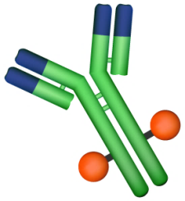
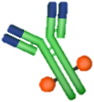
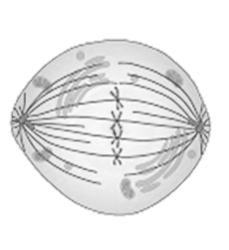
Introduction Antibody Drug Conjugate
ADC
(Antibody Drug Conjugate)
Antibody
Drug (ex: MMAE)
Receptor
Tumor cell

Slide 7
Introduction Antibody Drug Conjugate
ADC
(Antibody Drug Conjugate)
Brentuximab Vedotin: ADC anti-CD30
MF CD30+ patients:
Overall response > 4 months: 50%.
PFS: 9 months
Peripheral neuropathy: 45%.
SS patients were excluded from phase III trial
Antibody
Drug (ex: MMAE)
Receptor
Tumor cell
There is a great need to search for other therapeutic targets

Slide 8
Introduction Inducible T-Cell COstimulator
ICOS is a co-stimulation receptor that potentiates the T cell functions allowing an antigen-specific immune response
ANTIGEN PRESENTING CELLS
LYMPHOCYTES B
NON-HEMATOPOIETIC CELLS
ICOS-L
Survival and proliferation
Differentiation (Th1, Th2, Th17)
Cytokine production (IL4, IL5, IL6, IL10, IL21, TNFα, INFγ)
ICOS
Cooperation T-B
ACTIVE T_{EFF} LYMPHOCYTE

Slide 9
Introduction Inducible T-Cell COstimulator
ICOS is a target of choice for the treatment of CTCLs because it is expressed
by both tumor cells and T_{REGs}
ANTIGEN PRESENTING CELLS
LYMPHOCYTES B
NON-HEMATOPOIETIC CELLS
ICOS-L
ICOS-L
ICOS-L
ICOS
ICOS
ICOS
T_{REG} LYMPHOCYTE
MALIGNANT
T-LYMPHOCYTE
ACTIVE _{TEFF} LYMPHOCYTE
The K-S. Cancer Res. 2016
Bosisio F. Am J Dermatopathol 2015
Querfeld C. Cancer Immunol Res 2018

Slide 10
Introduction Goals
Expression of ICOS by tumor cells :
- In the skin of patients with MF and SS at different stages of the disease
- In the blood of patients with SS
1
Efficacy of anti-ICOS ADCs
- in vitro on MF and SS cell lines
- in vivo in mouse xenograft models with cell lines and PDX (Patients Derived Xenograft)
2

Slide 11
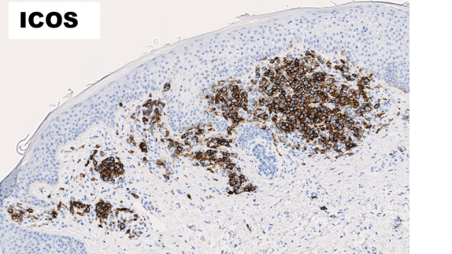
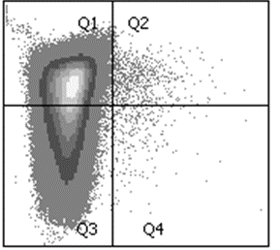
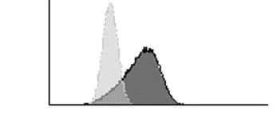
Materials and Methods ICOS Expression
PART 1 :
ICOS expression
ON THE SKIN: Immunohistochemistry
Tumor cell phenotyping: CD3+, CD4+, CD8- (CD7+/- CD26+/-)
IN THE BLOOD: Flow Cytometry
Tumor cell phenotyping: CD4+, CD158k+/-, CD7+/-, CD26+/-.
CD158e/k
ICOS
CD7

Slide 12
Results ICOS is widely expressed by malignant cells in the skin of patients with MF and SS
Ctrl -
Ctrl +
n=12
n=14
n=12
n=13

Slide 13
Results ICOS is widely expressed by malignant cells in the skin of patients with MF and SS
Ctrl -
Ctrl +
n=12
n=14
n=23
n=12
n=14
n=12
n=13
ICOS expression increases with
the progression of the disease and becomes widely expressed in SS

Slide 14
Results ICOS is widely expressed by malignant cells in the skin of patients with MF and SS
Ctrl -
Ctrl +
n=12
n=14
n=23
n=12
n=14
n=12
n=13
ICOS expression increases with
the progression of the disease and becomes widely expressed in SS

Slide 15
Results ICOS is widely expressed by malignant cells in the skin of patients with MF and SS
Ctrl -
Ctrl +
n=12
n=14
n=23
n=12
n=14
n=12
n=13
ICOS expression increases with
the progression of the disease and becomes widely expressed in SS

Slide 16
Results ICOS is widely expressed by malignant cells in the skin of patients with MF and SS
Ctrl -
Ctrl +
n=12
n=14
n=23
n=12
n=14
n=12
n=13
ICOS expression increases with
the progression of the disease and becomes widely expressed in SS

Slide 17
Results ICOS is widely expressed by malignant cells in the skin of patients with MF and SS
Ctrl -
Ctrl +
n=12
n=14
n=23
n=12
n=14
n=12
n=13
ICOS expression increases with
the progression of the disease and becomes widely expressed in SS

Slide 18
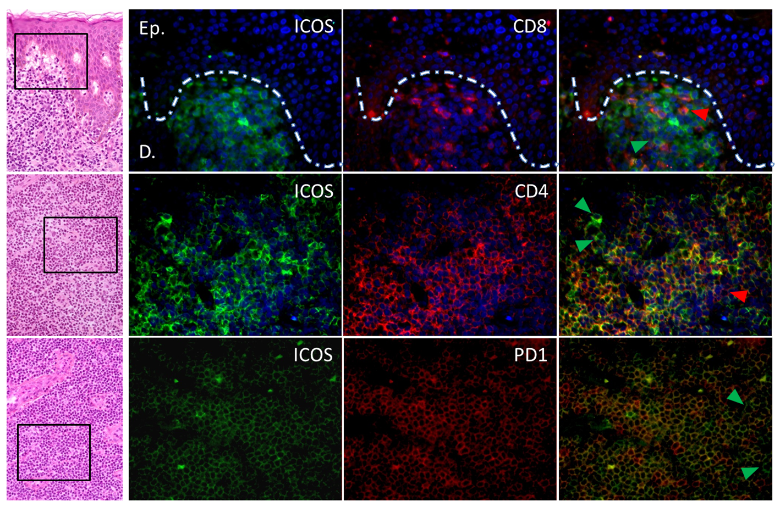
Results ICOS is widely expressed by malignant cells in the skin of patients with MF and SS
ICOS expression is mainly restricted to neoplastic CD4⁺ T cells,
with rare ICOS⁺CD8⁺ T cells or FoxP3⁺ Treg cells in the TME

Slide 19
Results ICOS is widely expressed by malignant cells in the blood of patients with SS
Percentages of lymphoid cell populations
using flow cytometry
13 patients:
12 healthy volunteers:

Slide 20
Results ICOS is widely expressed by malignant cells in the blood of patients with SS
ICOS expression:
By tumor cells:
By T_{REGS}:
ICOS is widely expressed by circulating tumor cells from patients with SS

Slide 21
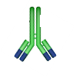
Materials and Methods Anti-ICOS ADCs: In vitro efficiency
2nd part :
FUNCTIONAL TESTS
Anti-ICOS ADCs
Generation of murine anti-ICOS mAbs
Coupling of an anti-ICOS antibody to :
MMAE (= idem Brentuximab)
Pyrrolobenzodiazepine (PBD)
ICOS⁺ CTCL cell lines
MyLa
MJ
Detection of cell viability

Slide 22
Results Anti-ICOS ADCs mediate killing of MyLa, MJ, and HUT78 cell lines
JURKAT
J-ICOS
MyLa
MJ

Slide 23
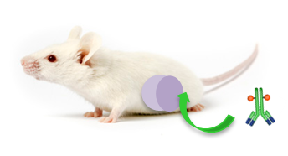
Materials and Methods Anti-ICOS ADCs: In vivo efficiency
Pre-clinical experimentations with murine xenograft models
→ MyLa cell line
→ PDX of Sézary Syndrom
From the Dana-Farber Cancer
Institute (Boston, MA).
→ PDX of other ICOS⁺ lymphomas
NSG mice

Slide 24
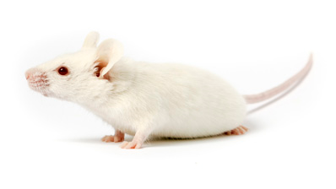
Materials and Methods Anti-ICOS ADCs: In vivo efficiency
Subcutaneous injection of 8.10⁶ MYLA cells
Intravenous injection of treatments
27 NSG mice
ADC anti-CD30
7 mice
ADC anti-ICOS-MMAE
7 mice
ADC anti-HER2
7 mice
Control group
6 mice
When tumors > 100 mm3
2 injections administrated (Day 1 and Day 4)
Monitoring of tumor volume with a caliper
GLOBAL SURVIVAL

Slide 25
Results In vivo, anti-ICOS-MMAE ADCs are superior to BV in terms of OS

Slide 26
Results In vivo, anti-ICOS-MMAE ADCs prevents the development of metastases
ICOS
CD30
HER2
J7
J14
Lungs
Spleen
Liver
J21
J28
J34
Metastases at D25
J40

Slide 27
Results Anti-ICOS-MMAE ADCs have a potent in vivo efficacy in PDXs of ICOS⁺ lymphomas
PDX of Sézary
AT J15:
Quantification of the number of tumor cells in blood and organs
Cytometry: quantification of tumor cells and equal distribution of treatment groups
PDX engraftment
Mice weight loss
= advanced stage
Treatment :
6 ADC anti-ICOS-MMAE mice
7 ADC anti-HER2 mice

Slide 28
Results Anti-ICOS-MMAE ADCs have a potent in vivo efficacy in PDXs of ICOS⁺ lymphomas
PDX of Sézary
AT J15:
Quantification of the number of tumor cells in blood and organs
Blood
Bone marrow
Spleen

Slide 29
Results Anti-ICOS-MMAE ADCs have a potent in vivo efficacy in PDXs of ICOS⁺ lymphomas
ICOS⁺ angio-immunoblastic lymphoma PDX
30 NSG mice
Vincristine
10 mice
ADC anti-ICOS
10 mice
Control Group
10 mice
Blast detection with cytometry at J21
Then treatment

Slide 30
Results Anti-ICOS-MMAE ADCs have a potent in vivo efficacy in PDXs of ICOS⁺ lymphomas
ICOS⁺ angio-immunoblastic lymphoma PDX

Slide 31
Discussion
1
ICOS: a new diagnostic marker for cutaneous T-cell lymphoma?

Slide 32
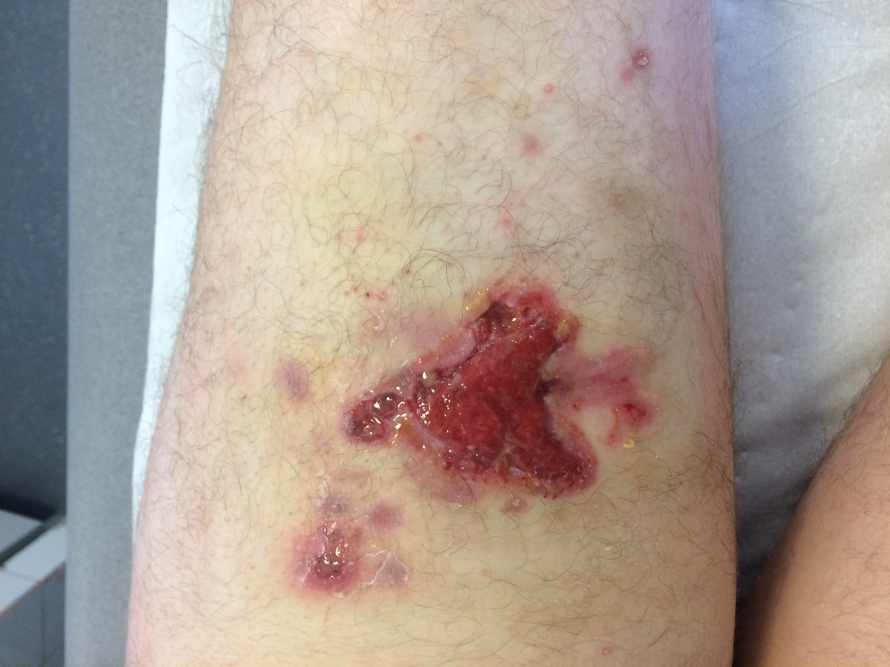
Discussion
1
ICOS: a new diagnostic marker for cutaneous T-cell lymphoma?
Transformed MF: ICOS+
Anaplastic large cell lymphoma: ICOS-

Slide 33
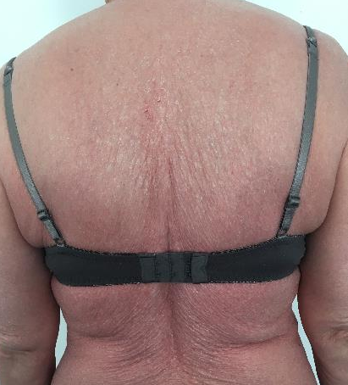
Discussion
1
ICOS: a new diagnostic marker for cutaneous T-cell lymphoma?
Sézary?
Drug reaction?

Slide 34
Discussion
1
ICOS: a new diagnostic marker for cutaneous T-cell lymphoma?
2
Anti-ICOS ADCs would induce a depletion of about 30-40% of non-tumor lymphocytes

Slide 35
Discussion
1
ICOS: a new diagnostic marker for cutaneous T-cell lymphoma?
2
Anti-ICOS ADCs would induce a depletion of about 30-40% of non-tumor lymphocytes
ADC: rapid efficacy but drug-related toxicity => remission before allograft or for a difficult clinical situation
ADCC: delayed efficacy but little cumulative toxicity => maintenance treatment (e.g. rituximab in B lymphomas)
3

Slide 36
Discussion
1
ICOS: a new diagnostic marker for cutaneous T-cell lymphoma?
2
Anti-ICOS ADCs would induce a depletion of about 30-40% of non-tumor lymphocytes
ADC: rapid efficacy but drug-related toxicity => remission before allograft or for a difficult clinical situation
ADCC: delayed efficacy but little cumulative toxicity => maintenance treatment (e.g. rituximab in B lymphomas)
3
4
Efficacy on other ICOS-expressing T-cell lymphomas

Slide 37
Conclusion
1
CTCLs are an unmet medical need
2
ICOS is a promising therapeutic target, because it is expressed both by tumor T cells and Treg cells
3
Excellent anti-tumor potential of anti-ICOS ADCs (and probably humanized anti-ICOS naked mAbs…)

