Slide 1
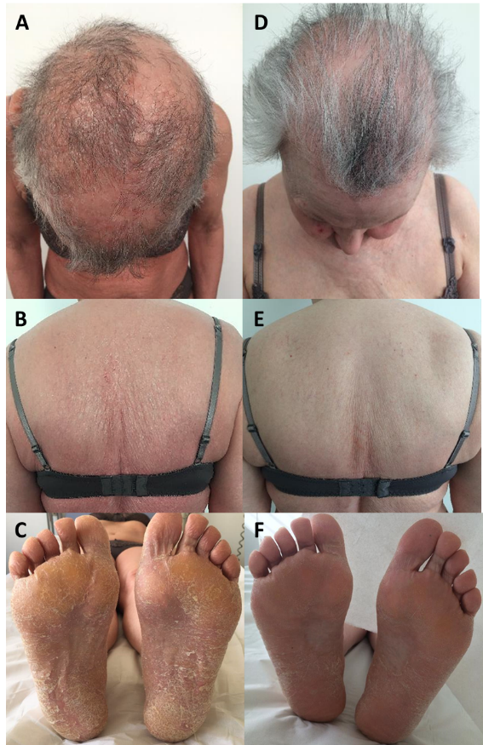
Tre-P-13
Mogamulizumab in a patient with Sézary syndrome
and severe atopic dermatitis
Amatore F, Connell E, Aymonier M, Gaudy-Marqueste C, Richard MA
Department of Dermatology and Skin Cancers, Hôpital de la Timone, Aix-Marseille Université, Marseille, France
INTRODUCTION
The chemokine receptor type 4 (CCR4) is involved in both Sézary syndrome (SS) and atopic dermatitis (AD) pathophysiology. Mogamulizumab (Moga), an anti-CCR4 monoclonal antibody, is labeled for the treatment of SS. We describe a patient for whom Moga had a benefit in both SS and AD.
OBSERVATION
45-year-old female patient, atopic history with asthma, rhinitis and severe AD since childhood
Successively treated with UVB phototherapy, ciclosporin and methotrexate, with partial response
Referred to our unit because of the rapid onset of erythroderma, ectropion and alopecia
Skin biopsy, peripheral blood lymphocyte immunophenotyping, and T-cell clonality were consistent with the diagnosis of stage IVB2 SS
Extracorporeal photopheresis and bexarotene were introduced, with a blood partial response but no efficacy on cutaneous symptoms. Dupilumab was also administered, resulting in an aggravation of the erythroderma.
Moga was then initiated. After 3 months, we observed a complete response in both skin and blood compartments (CD4⁺ T-cell population included 1% of CD7⁺CD26⁻CD158k⁺ atypical T cells, versus 68% before Moga, and CD4:CD8 ratio was 1:1 versus 15:1).
Interestingly, her eczema of the large folds, wrists, palms and soles that had been present since childhood had also decreased. In addition, the IgE level had normalized (11 versus 8952 kIU/L).
To date, neither SS nor AD has recurred under Moga with a 30-month follow-up
DISCUSSION
CCR4 plays a role in T-cell adhesion and skin homing
It is expressed by tumor cells in SS, but also in a normal physiological state by regulatory T cells (Treg) and Th2 cells
In SS, Moga inhibits tumor lymphocytes both directly and via Treg inhibition.
Figure 1. A-C: Clinical presentation before Moga initiation. D-F Clinical improvement at 3 months.
In AD, CCR4 is highly expressed by Th2 cells in the skin and blood
Its expression is higher than in a psoriasis plaque or in normal skin
The level of circulating CCR4⁺ lymphocytes correlates with the severity of AD
However, the role of Tregs in AD remains to be clarified
Finally, targeting CCR4 has been shown to be effective in mouse xenograft models of AD
To our knowledge, there are no studies on Moga in AD nor any reported cases of AD treated with Moga in humans, but a phase I trial is ongoing in asthma
CONCLUSION
Figure 2. Schematic representation of CCR4 expression in SS and AD.
G-H: In SS, CCR4 plays a role in tumor cell adhesion to the epidermis. Its targeting via Moga leads to an ADCC mechanism, and the killing of Tregs leads to a loss of inhibition of cytotoxic T-cells.
I: In AD, CCR4 also plays a role in adhesion of Th2 lymphocytes to the skin. Targeting CCR4 would allow their inhibition, thus decreasing the main cytokines responsible for the inflammatory cascade.
DC= dentritic cells. LTc = cytotoxic T-cell lymphocyte. NK = natural killer. IL = interleukine.
Our patient's observation reinforces the hypothesis that CCR4 is an attractive therapeutic target in AD. Human studies are needed to evaluate the efficacy and safety of anti-CCR4 in AD.
COI disclosure: Amatore F has a COI with Kyowa Kirin (Oral presentations and hospitality)

