Slide 1

Understanding the function of CD30 in cutaneous T-cell lymphoma –
implications for therapy and prognosis
Jana Albrecht, MD
Department of Dermatology, Venereology and Allergy, University Medical Center Mannheim
Clinical Cooperation Unit Dermato-Oncology, DKFZ
E-mail: jana.albrecht@umm.de

Slide 2
CD30 Receptor and CD30 Ligand
CD30 Receptor:
120 kD, type I transmembrane protein
No death domain
Can be shed in a soluble form
CD30 Ligand:
Type II transmembrane protein (TNFSF)
Expressed on various cell types
Soluble form of CD30L in human sera
Upper figure: Younes, A. & Aggarwall, B.B. Clinical implications of the tumor necrosis factor family in benign and malignant hematologic disorders. Cancer 98, 458-467 (2003).
Lower figure: Croft, M. Co-stimulatory members of the TNFR family: keys to effective T-cell immunity? Nat Rev Immunol 3, 609-620 (2003).

Slide 3
CD30 in Health and Disease
In healthy individuals, CD30 expression is restricted to a small number of activated B and T lymphocytes
Expression in hematologic malignancies:
Hodgkin´s disease
Anaplastic large-cell lymphoma
Immunoblastic lymphoma
Multiple myeloma
Adult T-cell lymphoma leukemia
Mycosis fungoides (MF)/ Sézary Syndrome

Slide 4
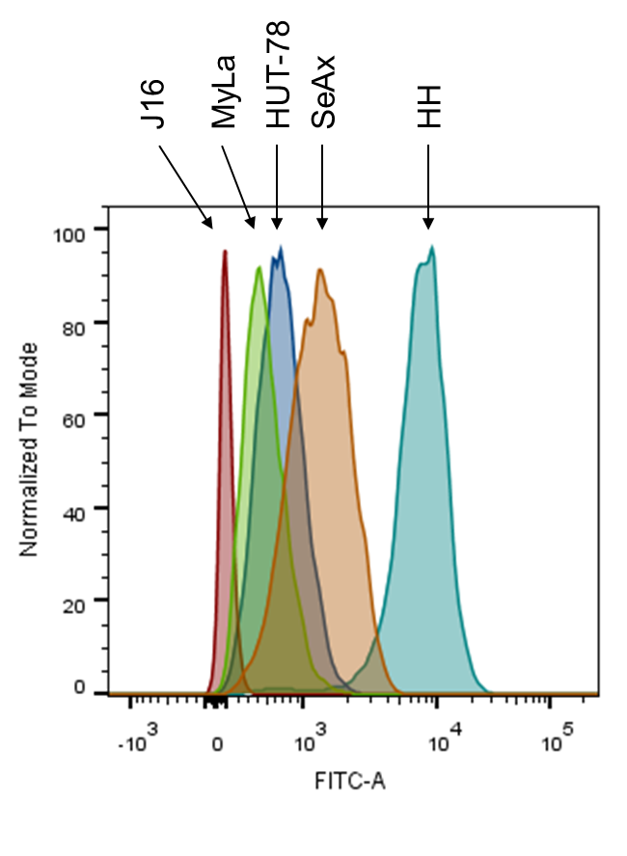
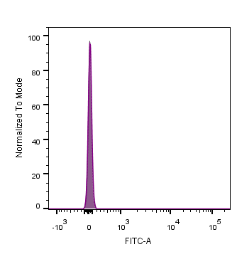
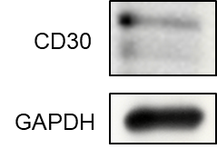
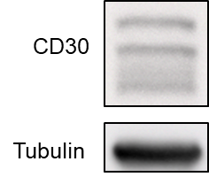
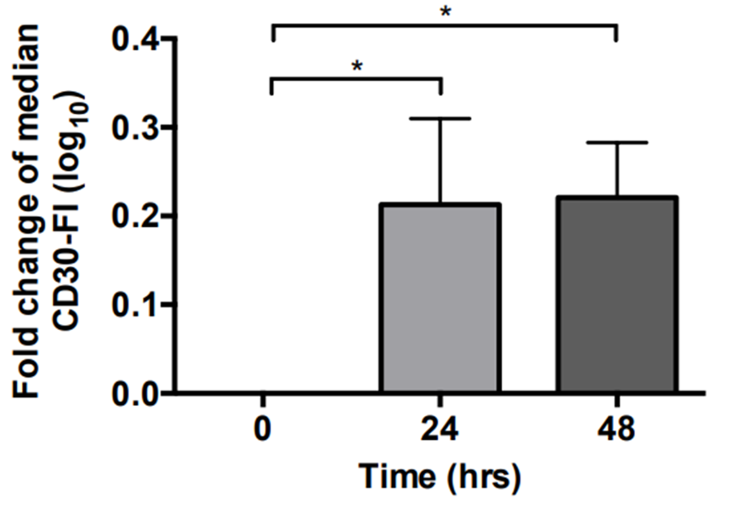
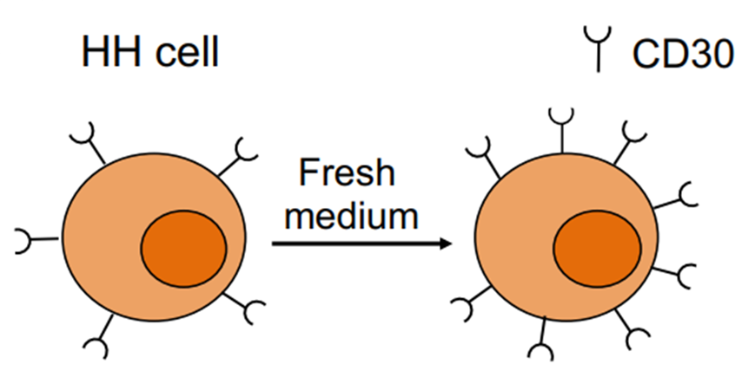
CD30 expression in vitro and ex vivo
Patient T-cells:
J16:
Dynamic of
CD30 expression:
*p < 0.05

Slide 5
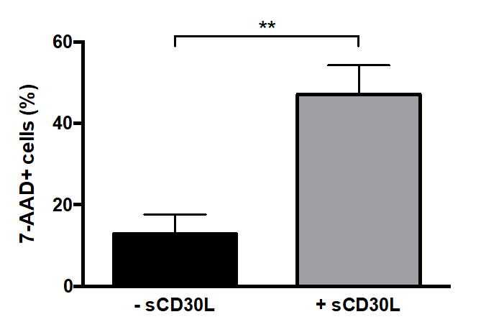

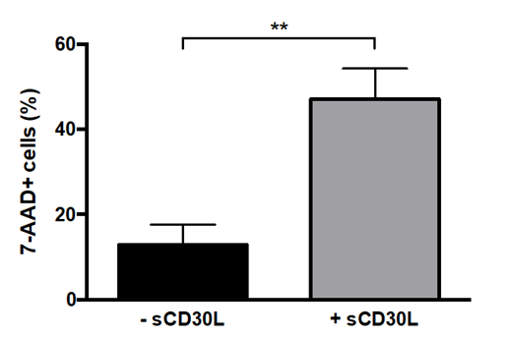
Soluble CD30L induced cell death – in vitro
HH
J16
**p < 0.01

Slide 6
Soluble CD30L induced cell death – in vivo
Preliminary!

Slide 7
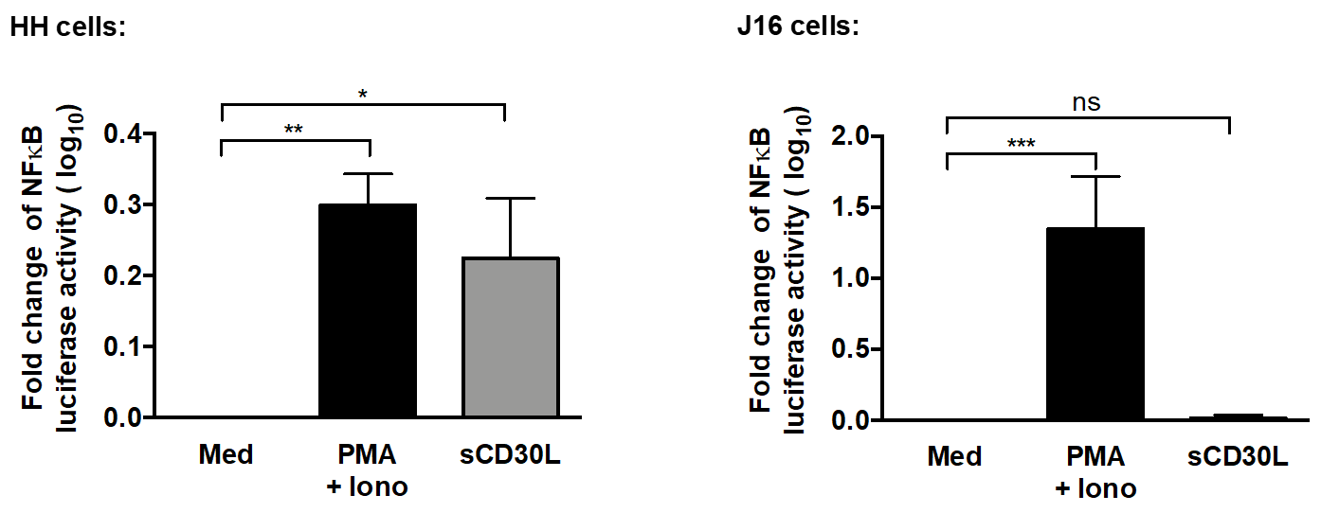
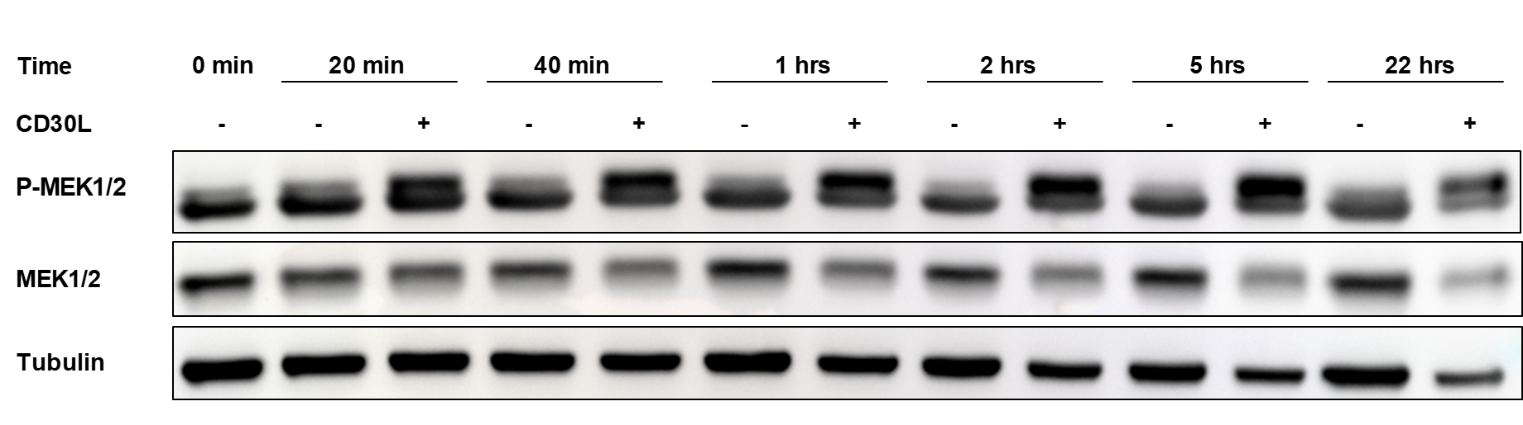
sCD30L induces NF-κB and MEK 1/2
***p < 0.001, **p < 0.01, *p < 0.05

Slide 8
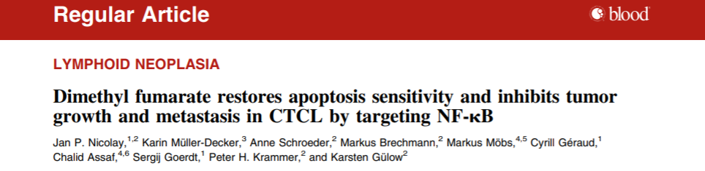
The influence of DMF on CD30 expression in CTCL

Slide 9
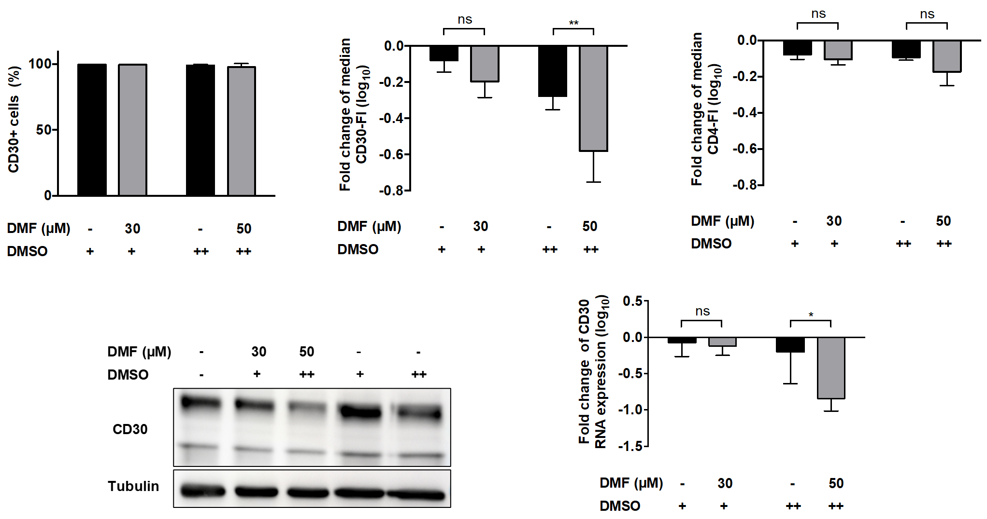
The influence of DMF on CD30 expression in CTCL
HH
**p < 0.01, *p < 0.05

Slide 10
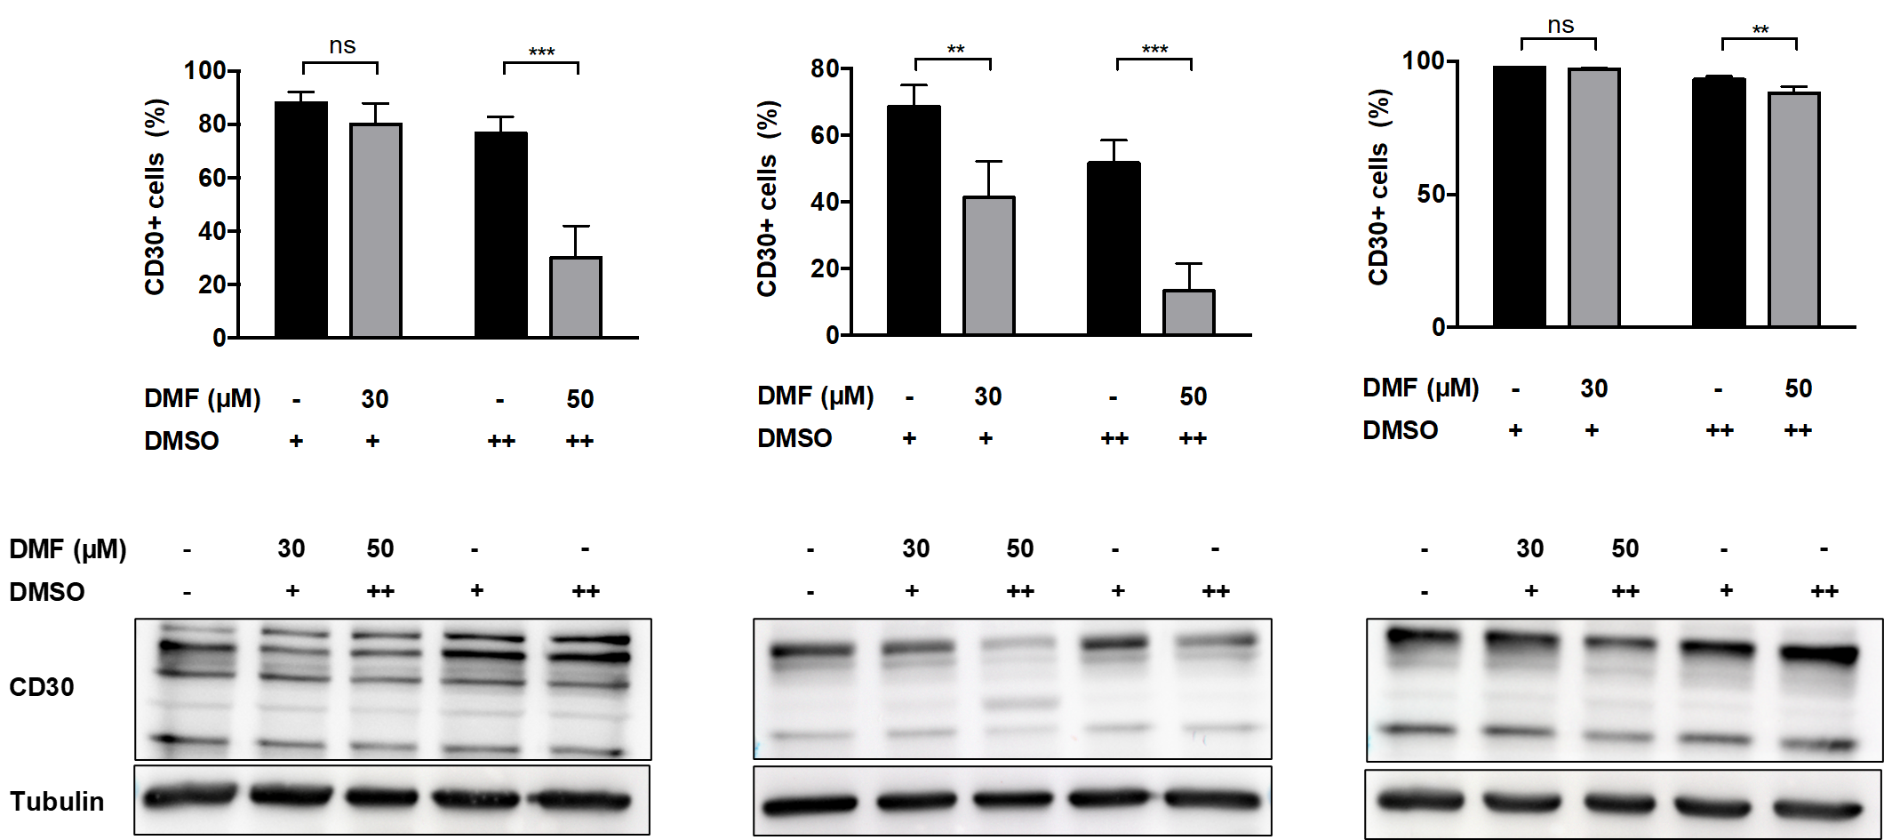
The influence of DMF on CD30 expression in CTCL
HUT-78
SeAx
***p < 0.001, **p < 0.01

Slide 11
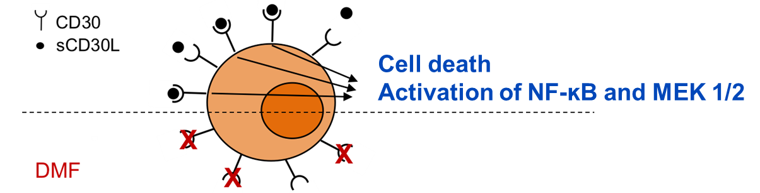
Summary
CD30 expression depicts a dynamic nature in CTCL, which might account for the described effectiveness of brentuximab vedotin directed to CD30 also in CD30 low-expressing patients^{1,} ².
Stimulation of CD30 by sCD30L induces cell death and activates NF-κB signaling pathway and MEK1/2.
DMF inhibits CD30 expression in CTCL cell lines.
¹ Jacobsen, et al. (2015). Brentuximab vedotin demonstrates objective responses in a phase 2 study of relapsed/refractory DLBCL with variable CD30 expression. Blood 125, 1394-1402.
² Prince, H.M., et al. (2017). Brentuximab vedotin or physician's choice in CD30-positive cutaneous T-cell lymphoma (ALCANZA): an international, open-label, randomised, phase 3, multicentre trial. Lancet 390, 555-566.

Slide 12
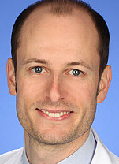

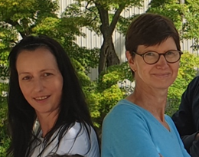

Acknowledgments
Prof. Jan P. Nicolay
Prof. Jochen Utikal
& his group
Dr. Tobias Hein
Ursula Matiba
Özge Çiçek Şener
Sandra Pfrang

