Slide 1
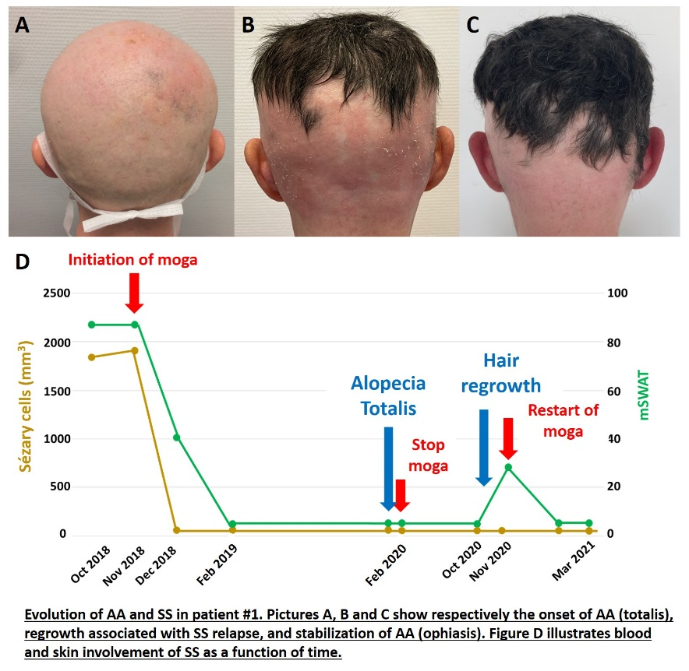
Is mogamulizumab-induced alopecia areata associated with
favorable outcomes in Sézary syndrome ?
Tre-P-11
Amatore F¹, Dereure O², Delaporte E¹, Ram-Wolff C³, Bagot M³
¹ Department of Dermatology, Aix Marseille University, APHM, North Hospital, Marseille, France
² Department of Dermatology, Montpellier University, Saint-Eloi Hospital, Montpellier, France
³ Department of Dermatology, Paris University, Saint-Louis Hospital, AP-HP, Paris, France
INTRODUCTION
Mogamulizumab (moga), an anti-CCR4 monoclonal antibody, is approved in cutaneous T-cell lymphomas (CTCL)
Moga immune-related adverse events (IrAE) have been described, and we report the first case series of alopecia areata (AA) following the administration of moga
OBSERVATIONS
Of 157 patients treated with moga through January 2021 (47 in the MAVORIC trial and 110 in "real life"), 4 developed AA: 3 alopecia totalis and 1 ophiasis
The patients were 3 women and 1 man with a median age of 59 years (35-81), all treated for stage IVA1 SS
They had no history of autoimmunity and no other IrAE
The median time to onset of AA after moga introduction was 12 months (6-16)
Upon the occurrence of AA, 2 patients had complete response (CR) of their SS, and 2 had good partial response (PR)
Skin biopsies were performed in 2 patients, revealing a peribulbar CD8⁺ T-cells infiltration with no evidence of a specific localization of SS
With a median follow-up of 49 months (18-76) since the introduction of moga, the AA was stable in 2 patients, for whom SS was still in CR or PR
In one patient, discontinuation of moga because of the pandemic was followed, 8 months later, by hair regrowth and relapse of SS. Restarting moga resulted in SS complete response with stabilization of the AA in an ophiasis type
Finally, one patient had a recurrence of SS at 18 months, leading to the discontinuation of moga, and her hair grew back completely. This patient is still alive in PR after an allogenic bone marrow transplantation.
DISCUSSION
CCR4 is expressed by Sézary cells and regulatory T-cells (Tregs). In SS, moga depletes CCR4⁺ Tregs, thus augmenting cytotoxic T-cells anti-tumor immunity. The loss of homeostasis between Tregs and effector T-cells would be at the root of IrAEs
In patients with alopecia totalis, it has been shown that the level of circulating and perifollicular Tregs is significantly low compared to healthy subjects
The frequency of moga-induced IrAEs is not exactly established. To our knowledge, only one patient with AA has been reported.
Patients with long-term CR after the occurrence of moga-induced IrAE have been described, although the relationship between IrAE and moga efficacy warrants further evaluation.
CONCLUSION
AA can arise without additional moga-induced IrAE. It seems to be associated with a good efficacy of moga, and its evolution seems to be correlated with that of the SS, but its predictive value on the long term has yet to be determined.
COI disclosure: F. Amatore: conflict of interest with Kyowa Kirin (accommodations); O. Dereure and M. Bagot: conflict of interest with Kyowa Kirin (Advisory Board members)

