Slide 1
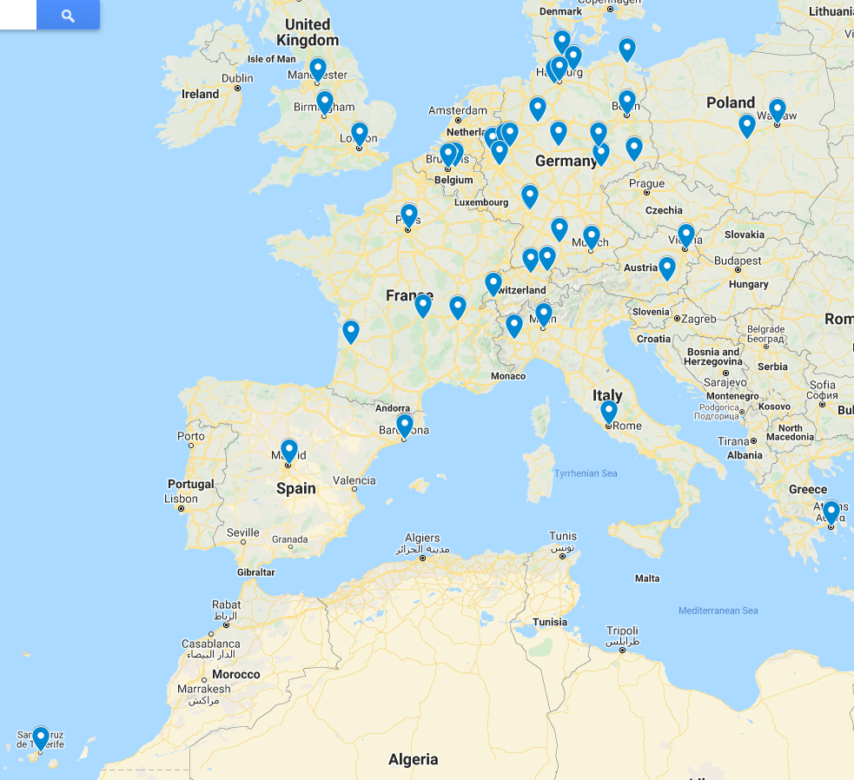
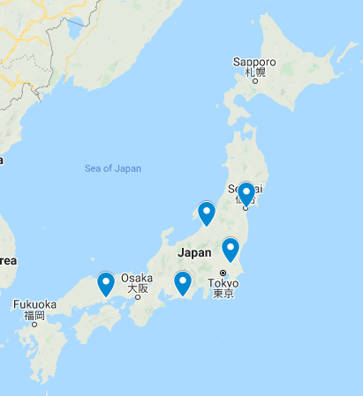
RESMAIN study - Evaluating resminostat for maintenance treatment of patients with advanced stage (Stage IIB‑IVB) mycosis fungoides (MF) or Sézary syndrome (SS)
Rudolf Stadler¹, Julia Scarisbrick², Pietro Quaglino³, Robert Knobler⁴, Matthias Borgmann⁵, Martin Orlovius⁵, Susanne Danhauser-Riedl⁵
¹ University Hospital of Dermatology, Minden, Germany; ² University Hospitals Birmingham NHS Foundation Trust, Birmingham, UK; ³ University of Turin, Turin, Italy; ⁴ Medical University of Vienna, Vienna, Austria; ⁵ 4SC AG, Planegg-Martinsried, Germany
ClinicalTrials.gov
Introduction
CTCL is characterized by the presence of a clonal T cell population in the skin and/or blood, lymph nodes or visceral organs. Patients with early disease can be treated effectively with topical treatments. However, a key challenge is to achieve durable remissions in patients with advanced disease who require systemic treatment. In malignant T cells of CTCL, epigenetic alterations are known to play a key role in pathogenesis. Resminostat is an orally available HDAC inhibitor, which induces changes in gene expression resulting in growth inhibition, modified cell differentiation and enhanced tumor immunogenicity. The purpose of the RESMAIN study is to investigate resminostat as maintenance treatment for patients with advanced stage mycosis fungoides (MF) or Sézary syndrome (SS) who have achieved disease control with systemic therapy. To our knowledge, this is the first randomized study that investigates an HDAC inhibitor as maintenance therapy in advanced-stage CTCL.
RESMAIN - Study Design
RESMAIN Sites and Status Update
Patients | Mycosis fungoides (advanced stages IIB-IVB) or Sézary syndrome CR, PR or SD 2-12 weeks after prior systemic therapy
Design | Maintenance treatment Primary endpoint: PFS Secondary endpoints: TTSW (pruritus), ORR, Safety, HrQoL, etc.
Europe
Resminostat
600 mg po, d1-5, q2w, N= 95
Follow Up
All open RESMAIN sites,
as of Sep 2021
A
PD
Randomization
Double-blind
Japan
1:1
B
Placebo
N=95
PD
Resminostat roll over
PD
Follow Up
CR: complete response; HrQoL; health related quality of life; ORR: overall response rate; PD: progressive disease; po: per os; PFS: progression-free survival; PR: partial response; q2w: every 2 weeks; SD: stable disease; TTSW: time to symptom worsening
Eligibility and Study Logistics
Site | City | Country | Patients
Universitaire Ziekenhuizen | Leuven | Belgium | 12
University Hospital | Birmingham | UK | 11
Universitätsspital | Zurich | Switzerland | 10
Ospedale Molinette | Turin | Italy | 8
Universitätsklinik | Göttingen | Germany | 7
Attikon Hospital | Athens | Greece | 7
Hospital Universitario 12 de Octubre | Madrid | Spain | 6
University Hospital | Niigata | Japan | 6
Johannes-Wesling-Klinikum | Minden | Germany | 5
St. Josef-Hospital | Bochum | Germany | 5
Universitätsklinik | Kiel | Germany | 5
Hôpital St. Louis | Paris | France | 5
CHU | Reims | France | 5
CHU | Lyon | France | 5
University Hospital | Tohoku | Japan | 5
Städtisches Klinikum | Ludwigshafen | Germany | 4
Charité | Berlin | Germany | 4
Universitätsklinik | Lübeck | Germany | 4
Kantonsspital | St. Gallen | Switzerland | 4
IFO San Gallicano | Rome | Italy | 4
Christie Hospital | Manchester | UK | 4
Total number of patients randomized |  |  | 185
Key Inclusion Criteria:
Patients (> 18 years) with histologically confirmed MF (Stage IIB-IVB) or SS in an ongoing CR, PR or SD after at least one prior systemic therapy according to local standards, including but not limited to interferon-α, bexarotene, extracorporeal photopheresis (ECP), chemotherapy or total skin electron beam (TSEB) therapy
The most recent systemic therapy must have been completed as planned or stopped due to unacceptable toxicity 2-12 weeks prior to randomization
ECOG performance score 0-2
Adequate hematological, hepatic and renal function
Key Exclusion Criteria:
Patients with PD
Baseline QTc interval > 500 ms
Concurrent use of any other specific anti-tumor therapy
Study Logistics:
Enrollment: 190 patients
Trial centers/countries: 43 centers in 10 European countries, 5 centers in Japan
Planned trial period:
FPI: Dec 2016
LPI: Q4 2021
LPO: Q3 2023
Table shows sites where more than 3 patients have been recruited, as of Sep 2021
Objectives
Primary objective:
Determine whether maintenance treatment with resminostat increases PFS compared to placebo.
Key secondary objective:
Determine whether resminostat delays the TTSW of pruritus compared to placebo.
Further objectives include time to progression, time to next treatment, overall response rate, overall survival, pharmacokinetics, safety and HrQoL and comprehensive biomarker evaluation.
Acknowledgement:
We thank the patients and their families for making this trial possible and the study teams and investigators for their contributions.
Sponsor Contact
RESMAIN@4sc.com
4SC AG
www.4sc.com
PI Contact: rudolf.stadler@ruhr-uni-bochum.de
Conflict of interest declaration - COI: No conflicts of interest to declare.
Sponsor Contact: RESMAIN@4sc.com
MB, MO and SDR are full time employees of 4SC AG

