Slide 1
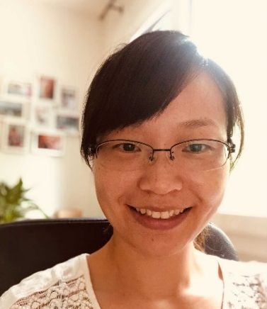

EORTC Cutaneous Lymphoma Group 20-21 meeting |14.10.2021
Boost of innate immunity cytokines as biomarkers of response to extracorporeal photopheresis in leukemic cutaneous T-cell lymphoma patients.
Yi-Chien Tsai
Doctorante
Presentation ID. Bio-P-13

Slide 2
Extracorporeal Photopheresis
First line treatment for L-CTCL
IL-1b and integrin signaling pathways
CD14+ monocytes → T cell proliferation ↓
NK cells activity ↑
T_{reg} function ↑
DCs and neutrophils apoptosis ↑
leukemic cutaneous T cell lymphoma (L-CTCL)
UVA
Mechanism? Response markers?
1.Knobler R et al. J Eur Acad Dermatol. 2020; 2. Ying Z, et al. Oncotarget. 2019; 3.Wiese F, et al. Clin Exp Immunol. 2019; 4.Iselin C, et al. Oncoimmunology. 2021; 5.Aisling M., et al, J Clin Immunol. 2021. 6. Franklin C. et al., PLoS One. 2015.
Yi-Chien Tsai

Slide 3
I. L-CTCL posses an altered serum cytokine profile
A . B.
Healthy donors
L-CTCL patients
Yi-Chien Tsai

Slide 4
II. ECP reponders’ PBMCs release higher innate immunity cytokines.
Yi-Chien Tsai

Slide 5
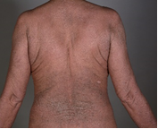
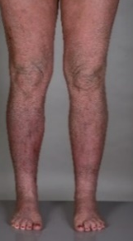
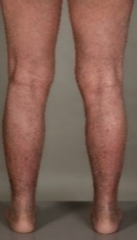
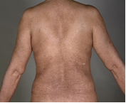
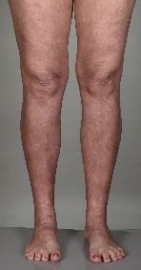
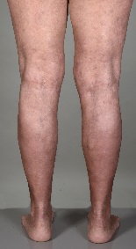
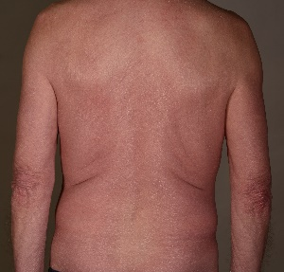
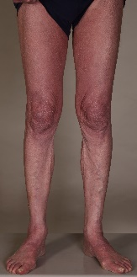
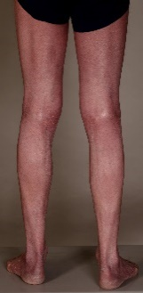
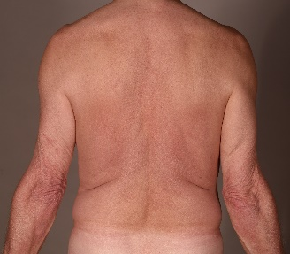
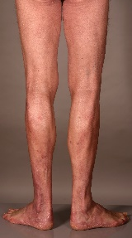
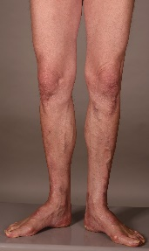
III. Immune profile recovery in the skin and blood of ECP responders.
A. B.
C.
Patient 1
before ECP
after
Patient 2
before ECP
after
Yi-Chien Tsai

Slide 6
L-CTCLs showed distinct a cytokine profile
  TNFa ↓
  IL-9, IL-12, and IL-13 ↑
PBMCs purified from ECP responders
  IL-1a, IL-1b, GM-CSF and TNFα ↑ (markers)
ECP boosts innate immune related mechanisms
Conclusion
Yi-Chien Tsai

Slide 7
EORTC Cutaneous Lymphoma Group 20-21 meeting |14.10.2021
Acknowledgements
Prof. Guenova group
Current:
Yun-Tsan Chang
Gabriela Blanchard
Prachitee Sirsikar
Christoph Iselin
Former:
Tanja Schlaepfer
Christina Fassnacht
Desislava Ignatova
Malgorzata Bobrowicz
Florentia Dimitriou
Prof. Boyman group
Alan Valaperti
Maya Vonow-Eisenring
THANK YOU!
Collaborators
Prof. Maiwald
Prof. Hoetzencker
PD. Pascolo
Boyko Amarov
Yi-Chien.Tsai@chuv.ch
Presentation ID. Bio-P-13

